Slide 1

Advanced Details for Adjacent Box Beam Connections
Ben Graybeal, Ph.D., P.E.
Team Leader – Bridge & Foundation Engineering
Federal Highway Administration
202-493-3122
benjamin.graybeal@dot.gov
Iowa DOT ABC Workshop — May 1-2, 2014

Slide 2
Considerations…
Acceptability/Unacceptability of current practice
Weaknesses to be addressed
Economic considerations
Bounds of new solution

Slide 3
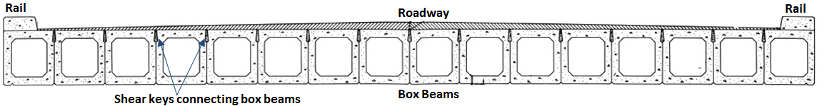
Objective
Enhance performance of adjacent box beam bridges
Focus on longitudinal connection details
  Assess common connection details
  Develop advanced connection details

Slide 4
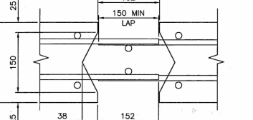

Field-Cast “Splice” Connections
Simple Lap-Splice Cxn
Smaller Grout Volumes
Shortened Bar Lengths
Emulates Monolithic
Component

Slide 5
Field-Cast “Splice” Connections
Precast
Deck Panels
and Slabs
Deck Bulb Tee
Girders

Slide 6
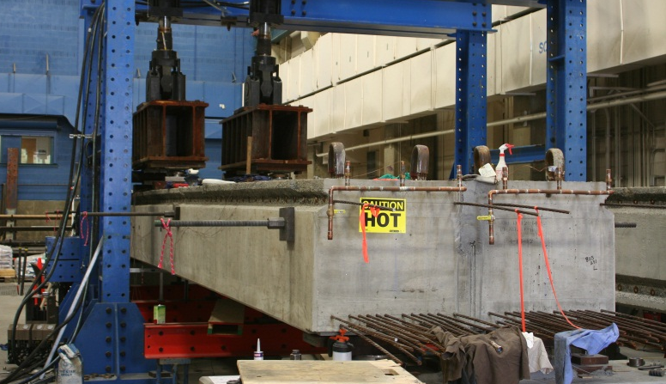
Adjacent Box Beam Connections

Slide 7
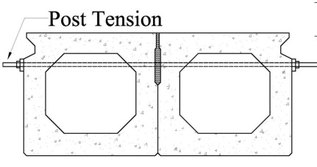
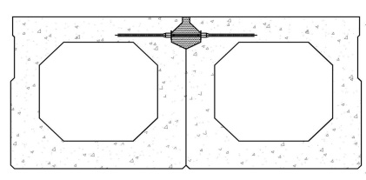
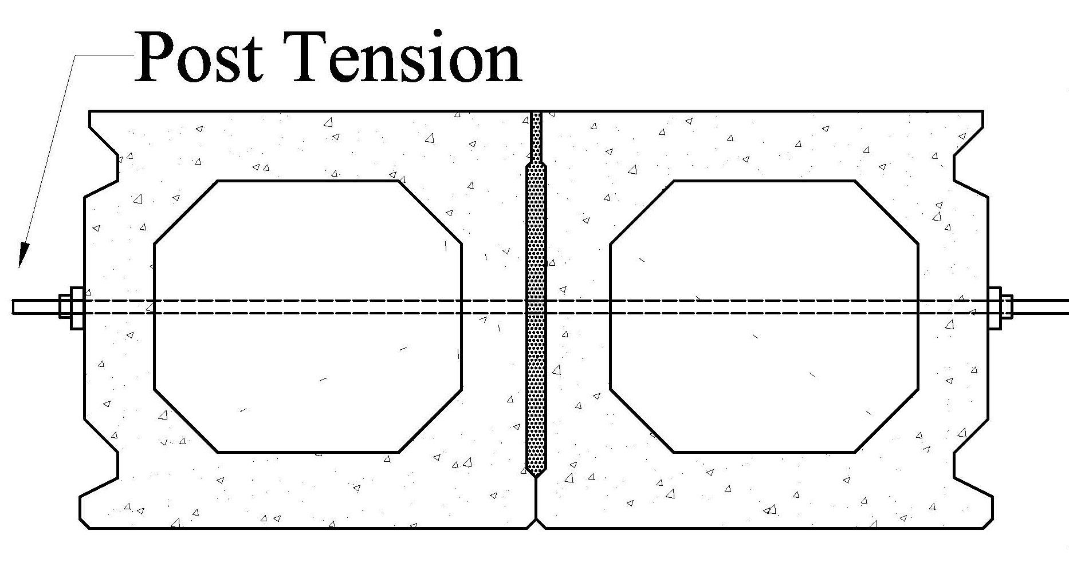
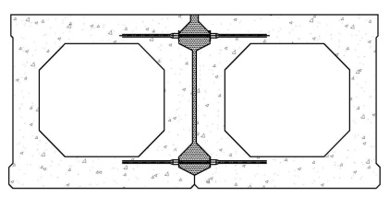
Adjacent Box Beam Connections
Traditional Solution
w/ Post-Tensioning
UHPC Connection Solution
w/o Post-Tensioning

Slide 8
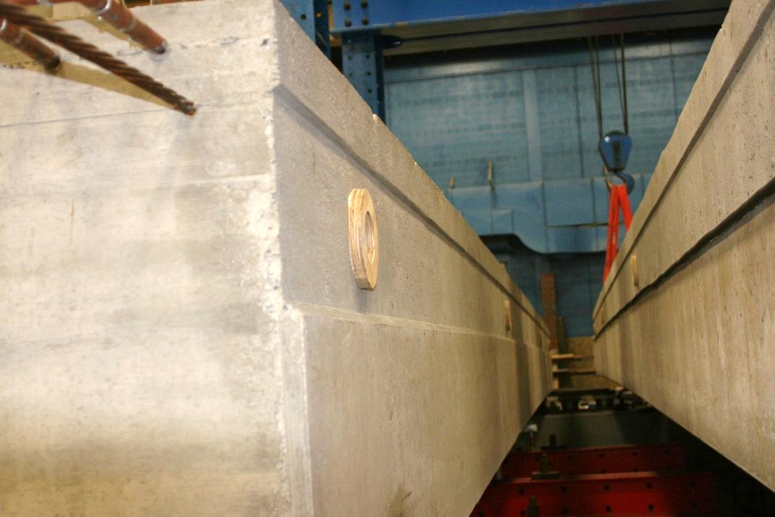
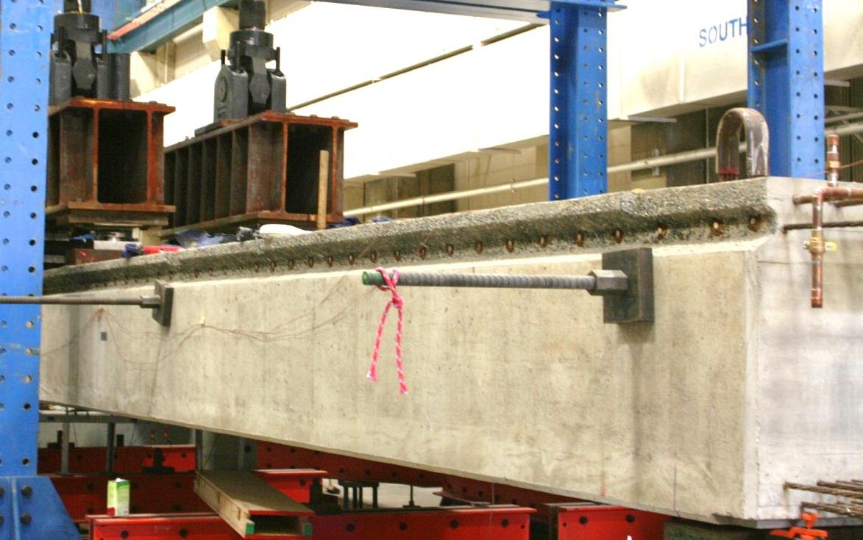
Conventional Shear Key
Post-Tension

Slide 9
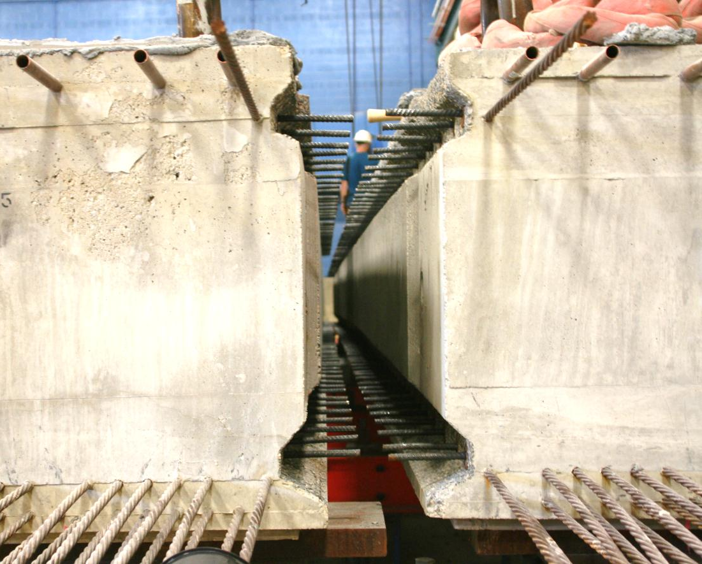
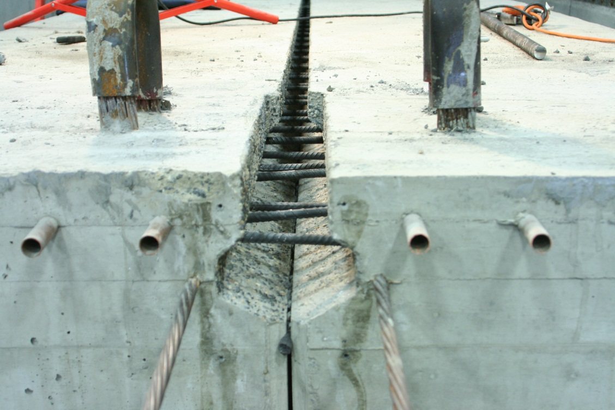
UHPC Connection
No. 4 rebar lap splice
(No Post-Tension needed)
Embedded Length: 5.5 in.
Lap spliced Length: ≈ 4in.

Slide 10
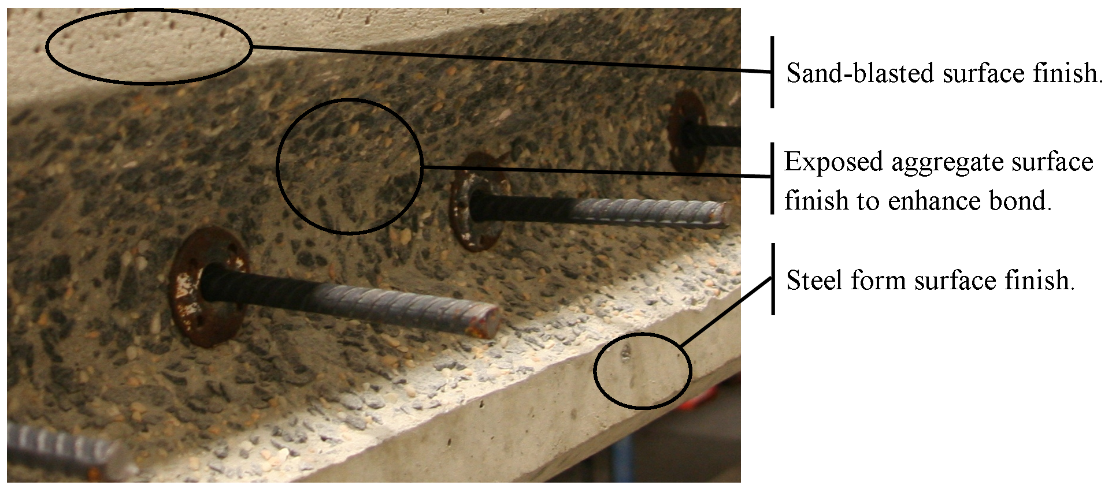
Surface Finishes

Slide 11
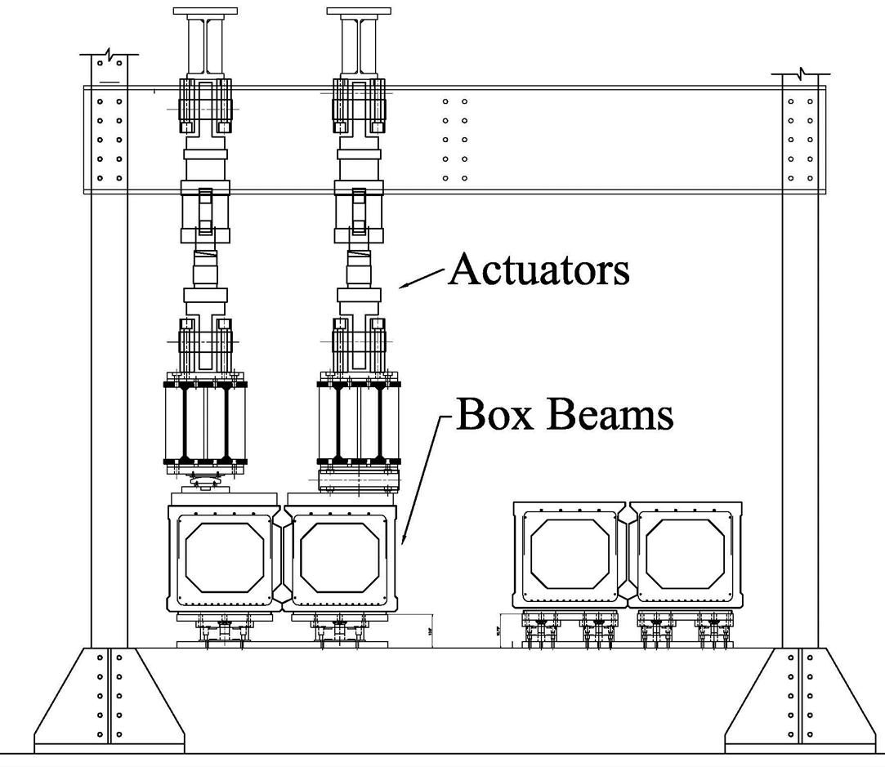
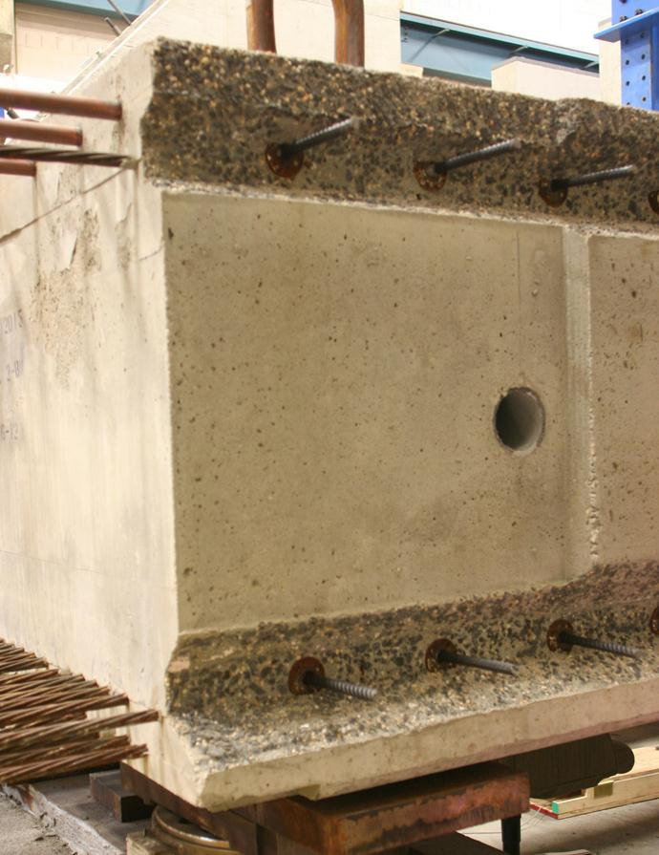
Adjacent Box Beam Connections
Loading

Slide 12
Adjacent Box Beam Connections

Slide 13
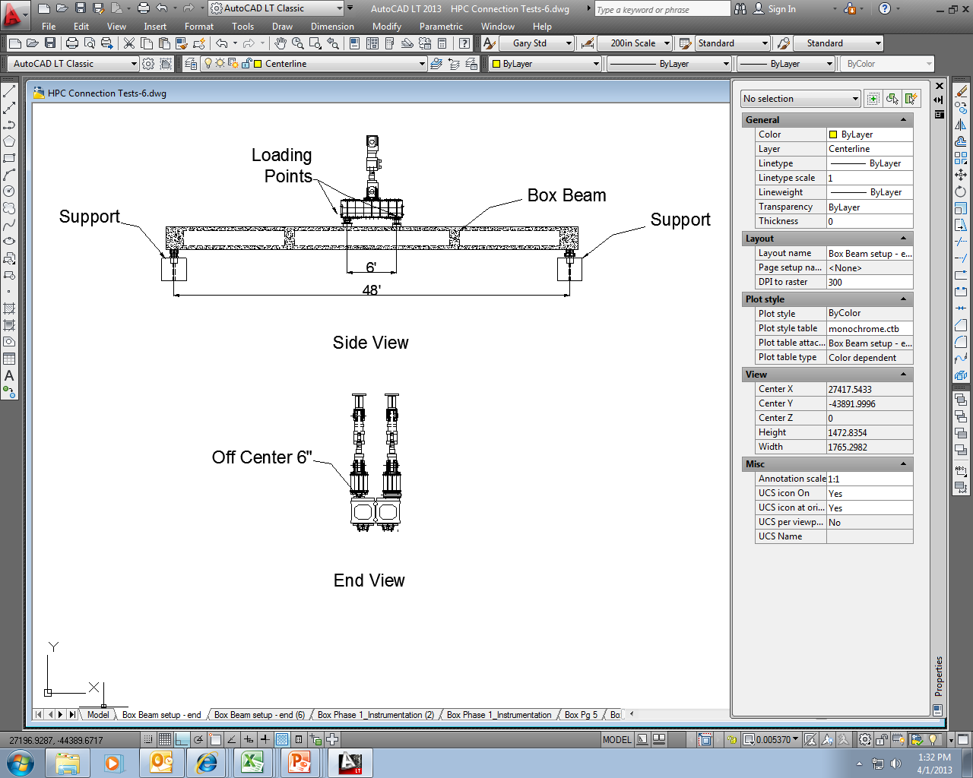
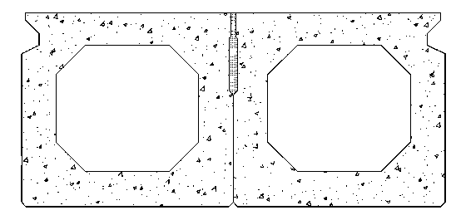
Simply Supported
Four Points Bending
Elevation
Off Center 6 in.
Cross Section

Slide 14
Loading Protocol #1 (Simply Supported)
Loading Range: 18, 36, 54, 72, 90 kips
Equivalent to the distributed load from a fatigue truck
Test Setup

Slide 15
Restrained Deflection
Four Points Bending
Elevation
Off Center 6 in.
Cross Section
Test Setup

Slide 16
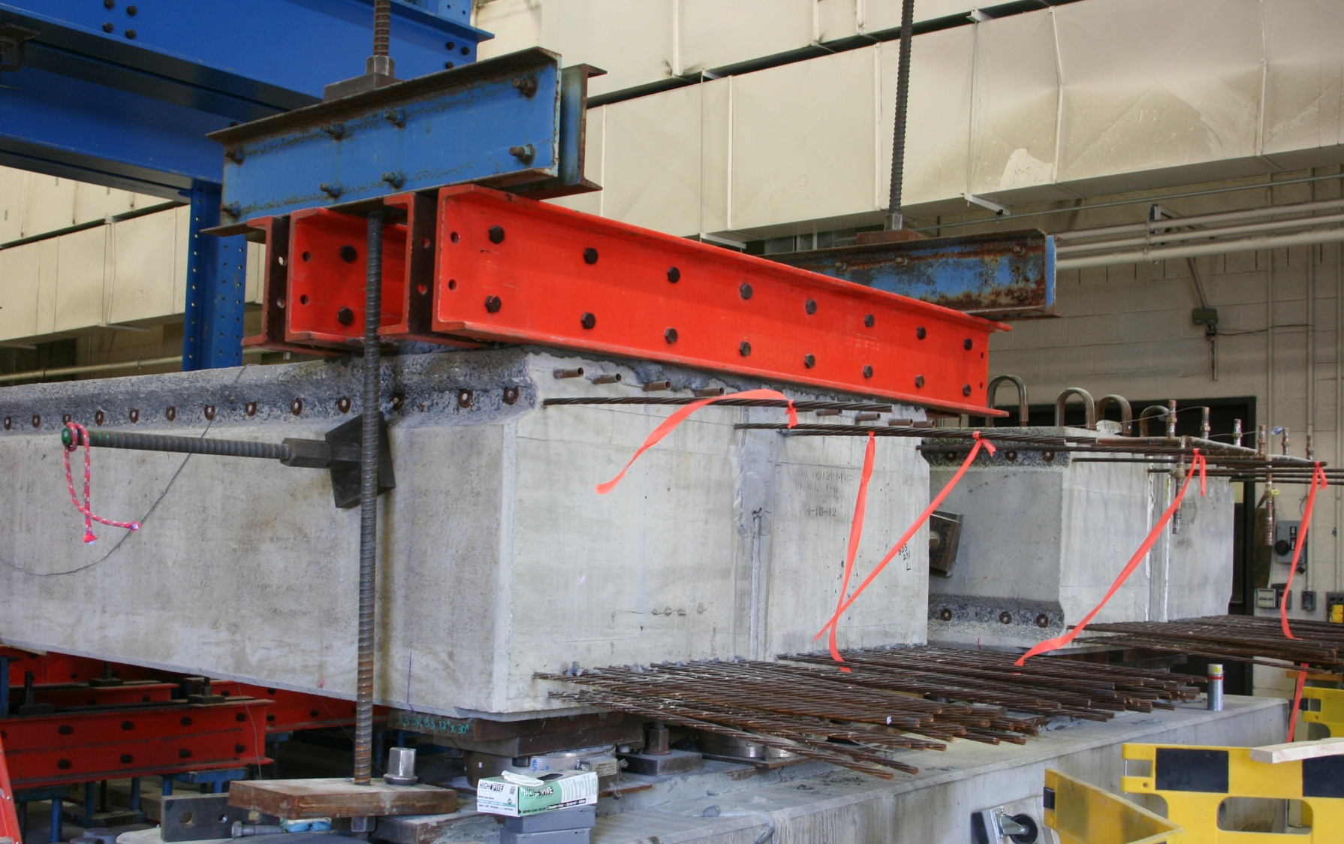
Restrained Rotation at Ends
Pull down force
Test Setup

Slide 17
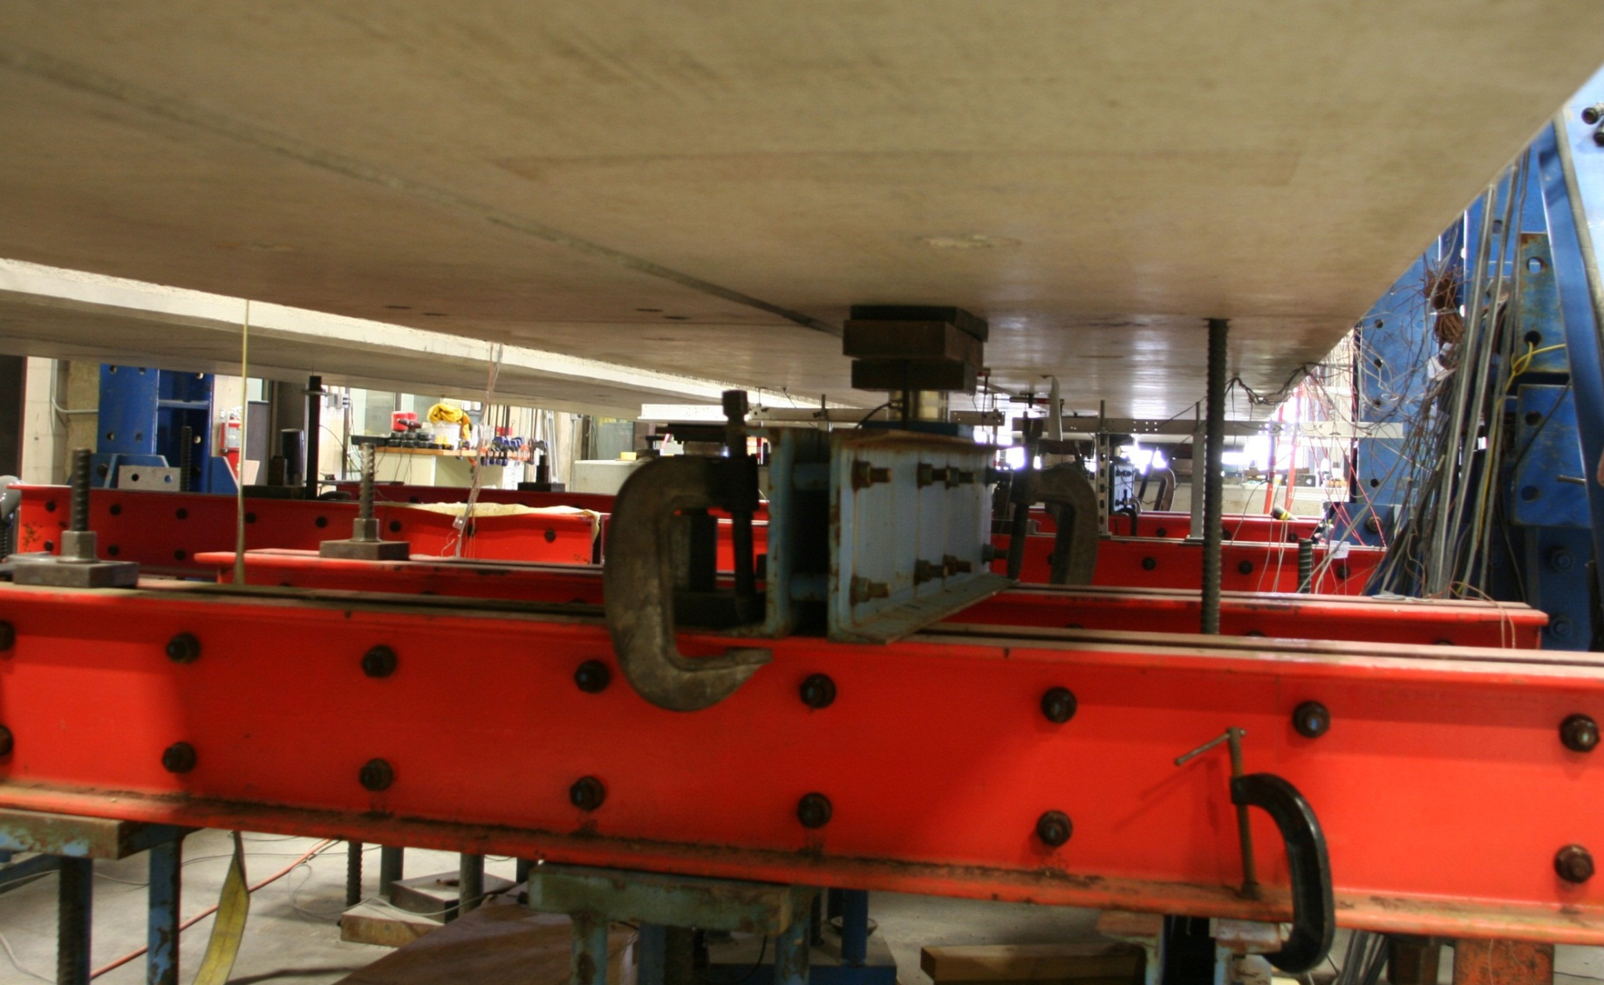
Restrained Deflection at Diaphragms
Beam 2
Beam 1
shear key
Pull down force
Support
Test Setup

Slide 18
Loading Protocol #2 (Restrained Deflection)
Loading Range: 18, 36, 54, 72, 90 kips
Test Setup

Slide 19
Conventional Grouted Shear Keys:
Thermal loading caused no distress
Traffic loading appears unlikely to initiate new cracks
Traffic loading will cause crack growth
Transverse PT has minimal effect before cracking
Transverse PT cannot stop crack growth
Conventional grouted keys can perform well
  Must avoid cracks (shrinkage, surface prep, etc.)

Slide 20
UHPC Shear Keys:
UHPC connections create a robust reinforced system
No distress generated in UHPC connections

Slide 21
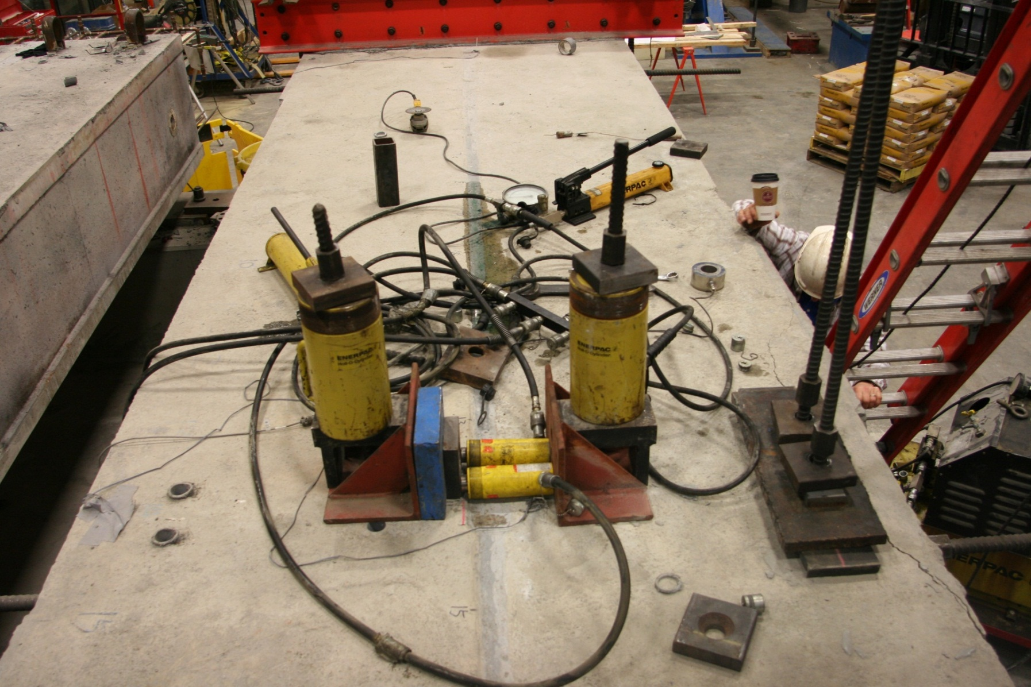
Cracking the Connection

Slide 22
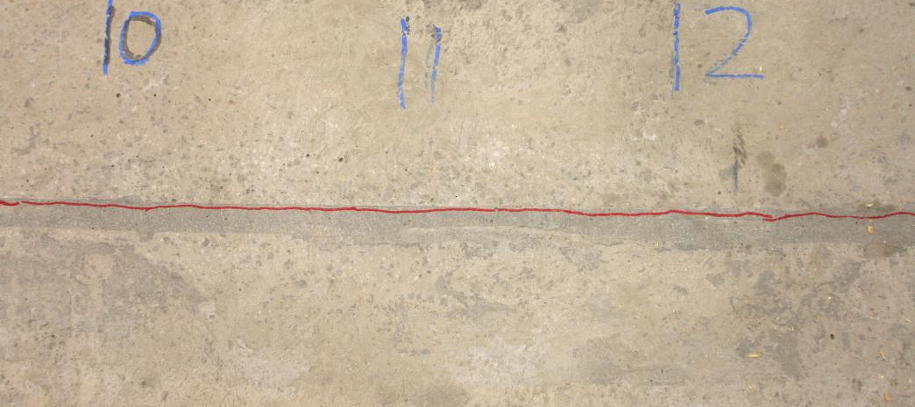
Conventional Grout & Partial Depth:
Crack at the interface
Conventional Connection
Observation: Transverse PT does not stop crack propagation

Slide 23
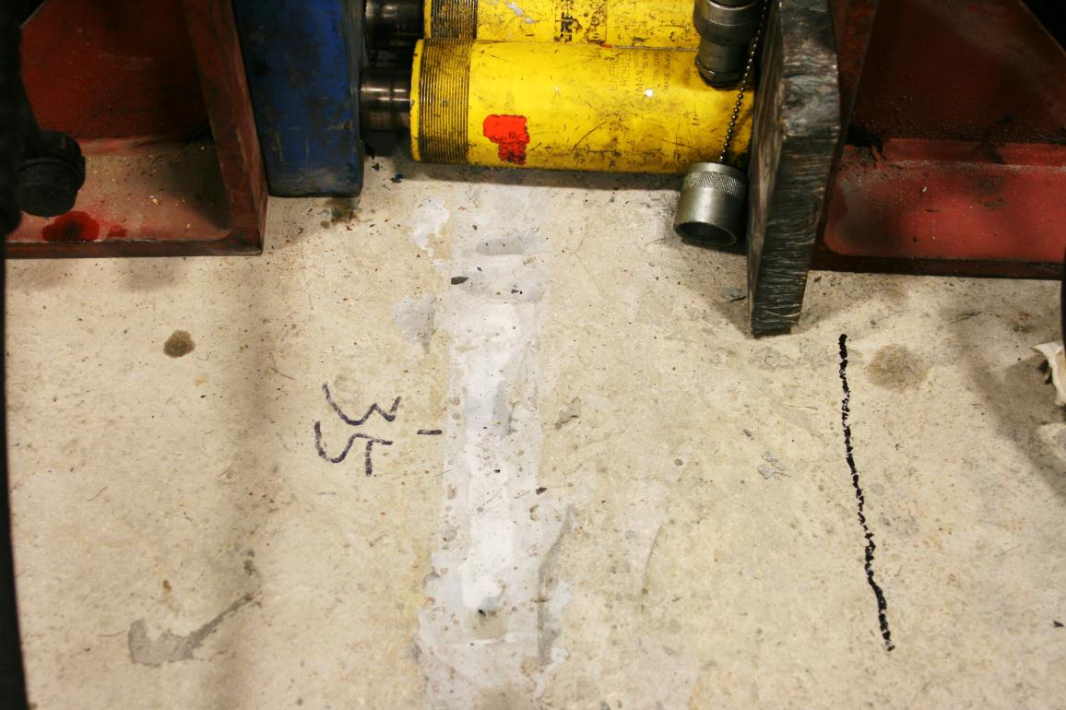
UHPC Connection w/o PT
Cyclic structural loads did not initiate cracks
Under forced cracking → crack in box beam
Connection

Slide 24

Full-Depth Conventional Grout
Beam A
Beam B
(a)
Transverse force
Beam A
Beam B
(b)

Slide 25
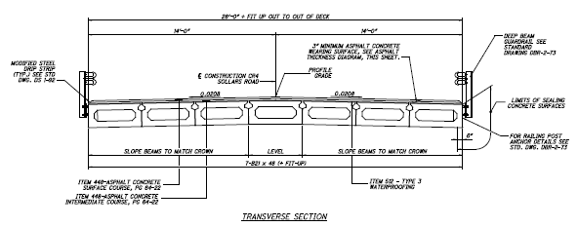
Sollars Road Bridge

Slide 26
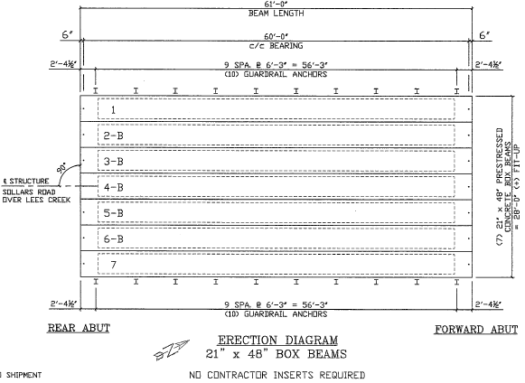
Sollars Road Bridge

Slide 27
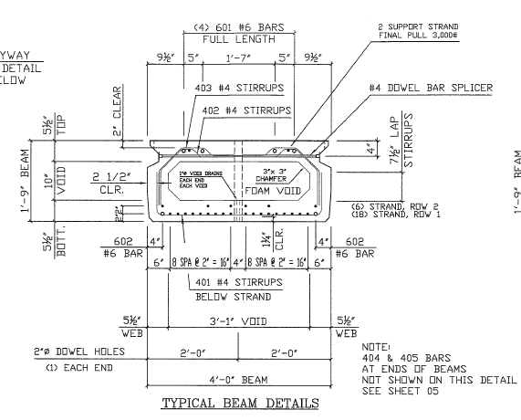
Sollars Road Bridge

Slide 28
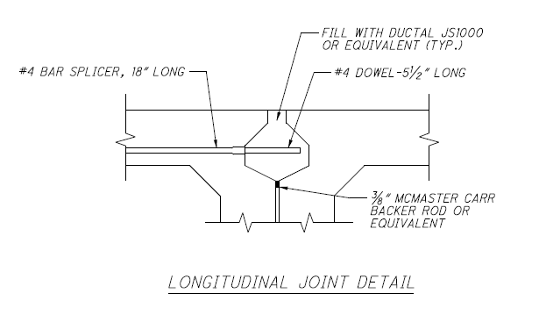
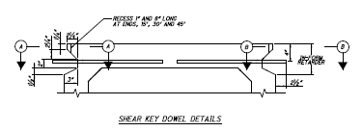
Sollars Road Bridge

Slide 29
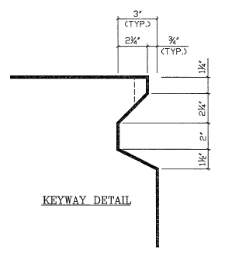
Sollars Road Bridge

Slide 30
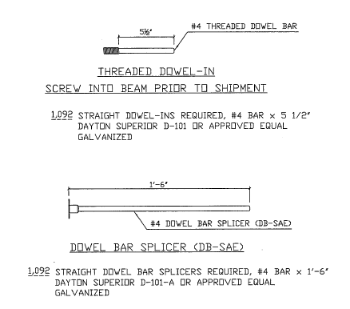
Sollars Road Bridge

Slide 31
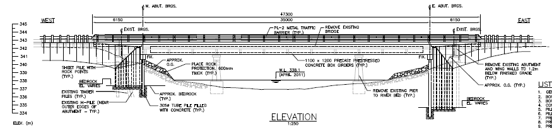
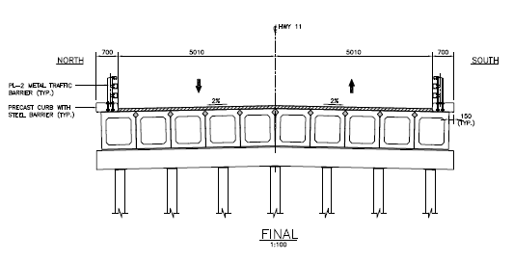
Sturgeon River Bridge

Slide 32
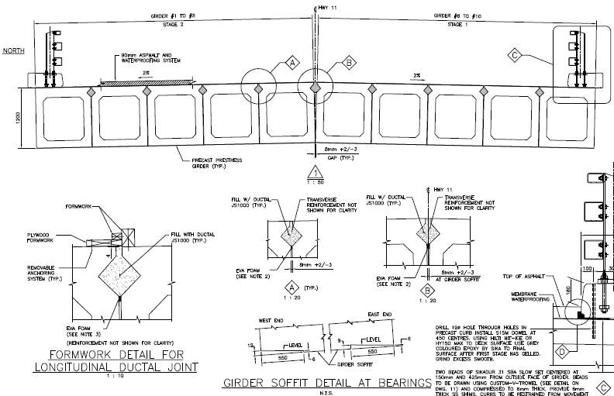
Sturgeon River Bridge

Slide 33
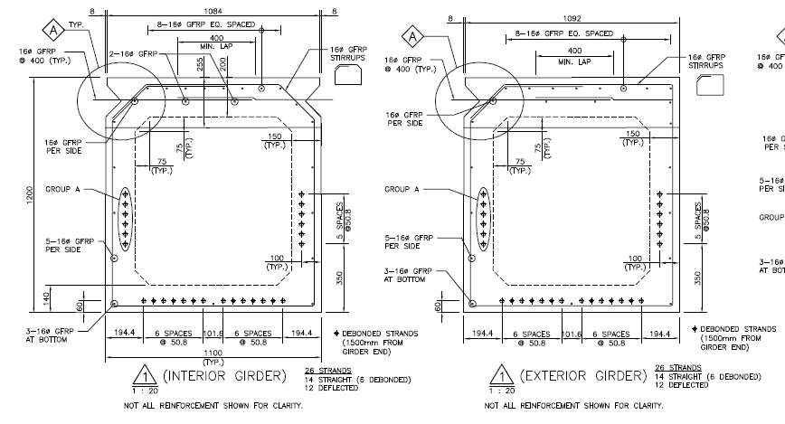
Sturgeon River Bridge

Slide 34
Considerations…
Acceptability/Unacceptability of current practice
Weaknesses to be addressed
  Connection Deterioration? Differential Movement? Corrosion?
Economic considerations
Bounds of new solution
  PT or No PT? Surface Preparation? UHPC? GFRP?

Slide 35
Advanced Details for Adjacent Box Beam Connections
Ben Graybeal, Ph.D., P.E.
Team Leader – Bridge & Foundation Engineering
Federal Highway Administration
202-493-3122
benjamin.graybeal@dot.gov
Iowa DOT ABC Workshop — May 1-2, 2014

Slide 36

Guidance on Use of
UHPC Connections
FHWA document being drafted
  Design guidance
  Construction guidance
  Case Studies
Publication within 6 months
External reviews underway

