Slide 1

UHPC for PBES Connections:
A Path to Accelerated Construction and Enhanced Bridge Performance
Ben Graybeal, Ph.D., P.E.
Team Leader – Bridge & Foundation Engineering
Federal Highway Administration
202-493-3122
benjamin.graybeal@dot.gov
Iowa DOT ABC Workshop — May 1-2, 2014

Slide 2
Performance
Serviceability
Strength
Resiliency
Sustainability
Longevity
Cost-Effectiveness

Slide 3
Prefabrication
Connections
Connections
Connections

Slide 4
PBES Connections
Must be: – Robust, Ductile, Durable
Frequently: – Emulative

Slide 5
PBES Connections
Must be: – Robust, Ductile, Durable
Frequently: – Emulative
What we need: – Strong, Durable Material
– Good Bond to Concrete
– Good Bond to Rebar
– Self Consolidating
– Sustained Tensile Strength
– Short Development Length

Slide 6
PBES Connections
What we need: – Strong, Durable Material
– Good Bond to Concrete
– Good Bond to Rebar
– Self Consolidating
– Sustained Tensile Strength
– Short Development Length

Slide 7
Solution:
PBES Connections
What we need: – Strong, Durable Material
– Good Bond to Concrete
– Good Bond to Rebar
– Self Consolidating
– Sustained Tensile Strength
– Short Development Length
UHPC

Slide 8
What is Ultra-High Performance Concrete?
ACI 239 – Ultra-High Performance Concrete
  Concrete, ultra-high performance - concrete that has a minimum specified compressive strength of 150 MPa (22,000 psi) with specified durability, tensile ductility and toughness requirements; fibers are generally included to achieve specified requirements.

Slide 9
What is Ultra-High Performance Concrete?
Advanced cementitious composite material
High strength, high stiffness
Exceptional durability
Internal steel fiber reinforcement for added ductility
Self-consolidating
150⁺ MPa Compression
5⁺ MPa Tension
Fiber Reinforced
Self-Consolidating
Low Permeability

Slide 10
Introduction to UHPC
NHI Innovations Webinars – November 18, 2010 and April 21, 2011
FIU ABC Webinar – September 29, 2011
TechNote: UHPC
  FHWA HRT-11-038
  Aimed at DOTs and practitioners
  General information on casting,
  curing, testing, applications,
  inspection, etc.
  Web Search:
  UHPC TechNote

Slide 11

UHPC State-of-the-Art Report
FHWA HRT-13-060
  300+ references
  600+ item bibliography
  Materials, Performance,
  Design, Applications, Outlook
  Web Search:
  UHPC State of the Art

Slide 12
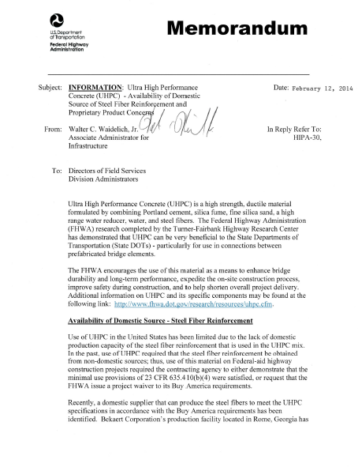
FHWA UHPC Memo – 12 Feb 2014
Buy America re: Fibers
Availability
Proprietary Products
Example Special Provision
(NYSDOT)

Slide 13
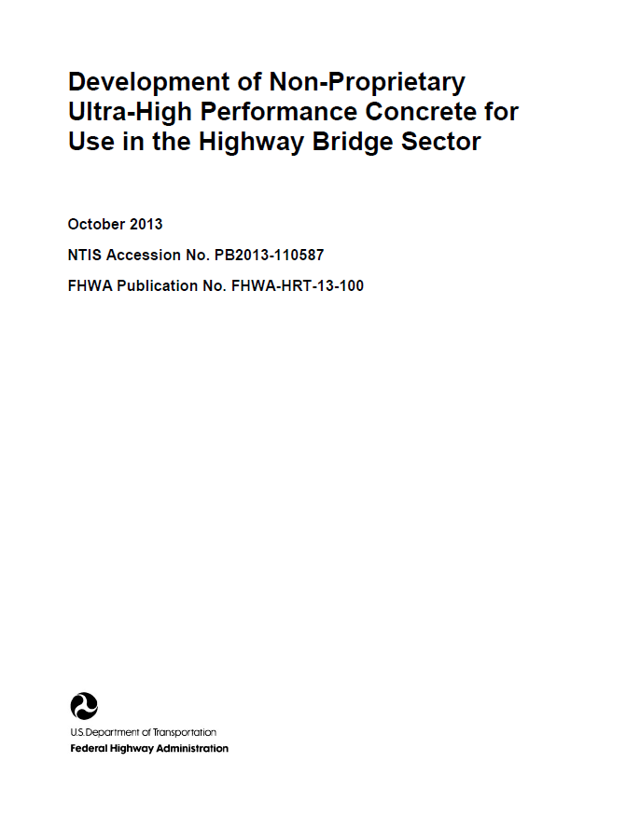
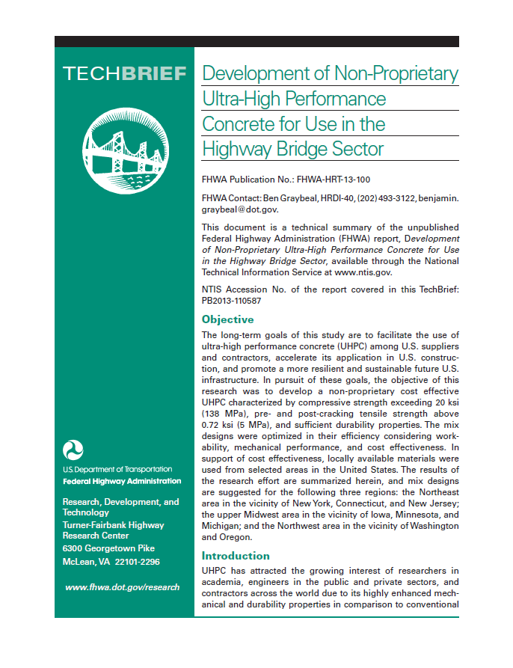
Non-Proprietary UHPC
Full Report on Study Results
Report: NTIS PB2013-110587
TechBrief: FHWA HRT-13-100

Slide 14
FHWA UHPC Website
https://www.fhwa.dot.gov/research/resources/uhpc/
Web Search: UHPC FHWA
Overview, Research Projects, Bridges, Publications

Slide 15
UHPC Connections
Deck-to-Deck
Deck-to-Girder
Column-to-Footing/Cap
Girder-to-Girder
Deck-to-Barrier
Deck-to-Expansion Joint

Slide 16
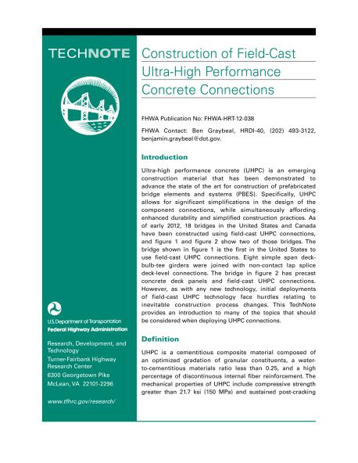
TechNote: UHPC Connections
FHWA HRT-12-038
  Aimed at DOTs and practitioners
  General information on
  field-cast use of UHPC
  Web Search:
  UHPC Connections TechNote

Slide 17
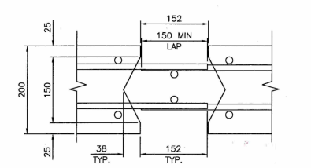

Field-Cast “Splice” Connections
Simple Lap-Splice Cxn
Smaller Grout Volumes
Shortened Bar Lengths
Emulates Monolithic
Component

Slide 18
Field-Cast “Splice” Connections
Precast
Deck Panels
and Slabs
Deck Bulb Tee
Girders

Slide 19
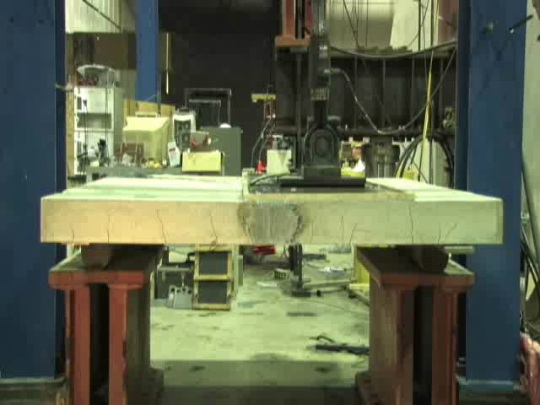
Deck-Level UHPC Connections
Notes:
The photo shows panel B1/B2 under cyclic load. The pond can be seen on the surface of the panel.

Slide 20
Slab/Plate/Deck Connections w/ UHPC
(25 mm)
1”
6” (152 mm)
5.9” (150 mm)
8” (203 mm)
LAP
5.9” (150 mm)
1.5”
6” (152 mm)
(38 mm)
Field-Cast, Non-Contact Lap Splice Connection

Slide 21
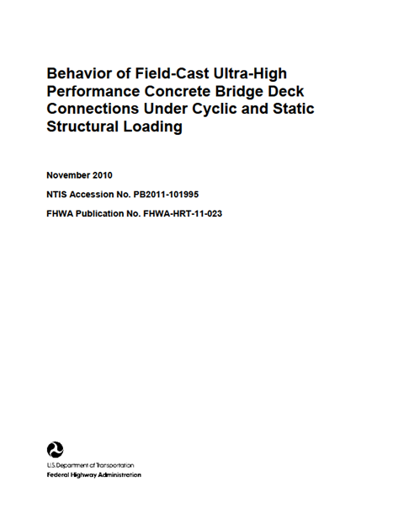
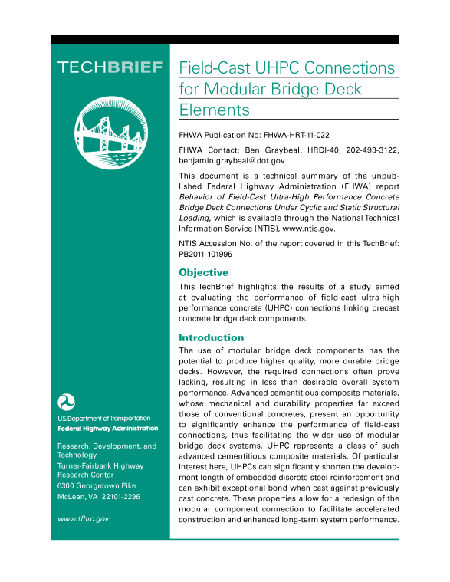
Deck-Level UHPC Connections
Full Report on Study Results
Report: NTIS PB2011-101995
TechBrief: FHWA HRT-11-022

Slide 22
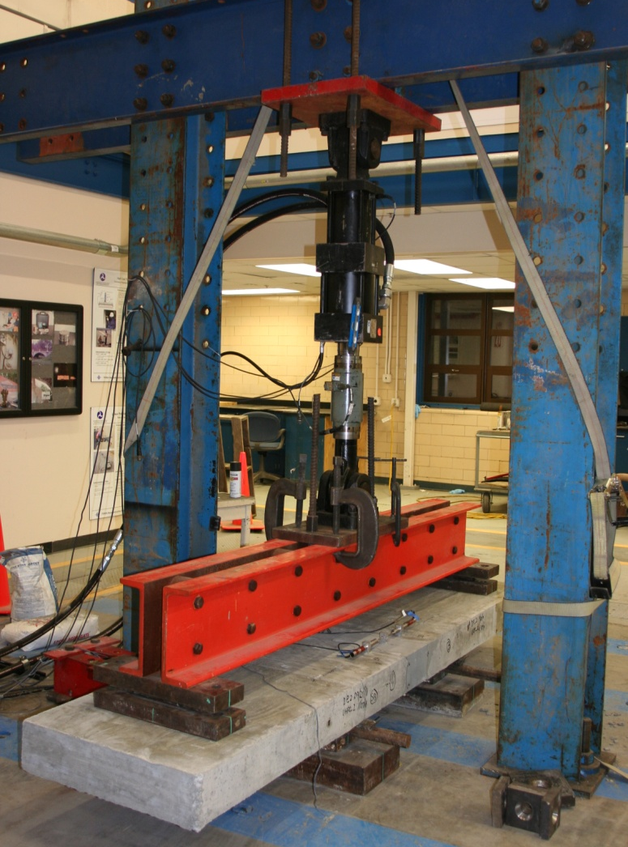
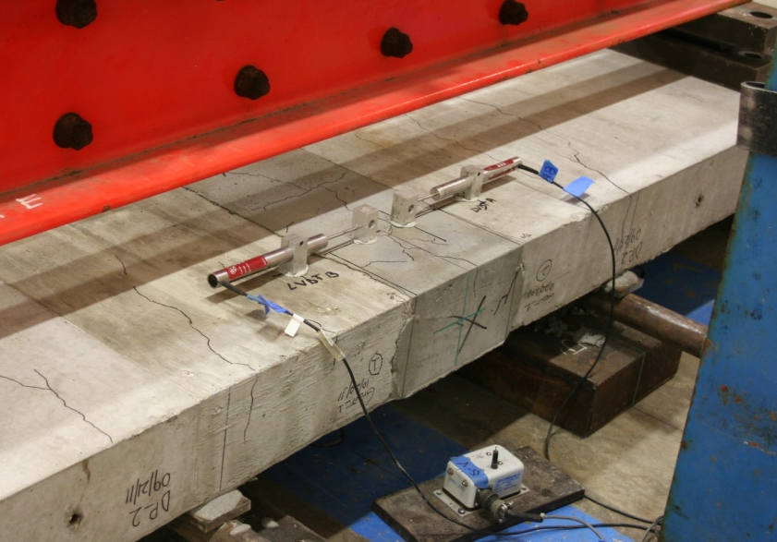
Panel-to-Panel UHPC Connections
4-point bending test
High-cycle fatigue then static to fail

Slide 23
22 panel-to-panel connections w/ UHPC
#5 bars lap-spliced 5.5” in 6” wide connection
Considered bar type, lacers, interface prep
2M+ cycles fatigue; static to failure
Results:
No failures in UHPC connections.
Observed failure modes –
conventional concrete crushing
steel rebar fatigue
steel rebar yielding / fracture

Slide 24
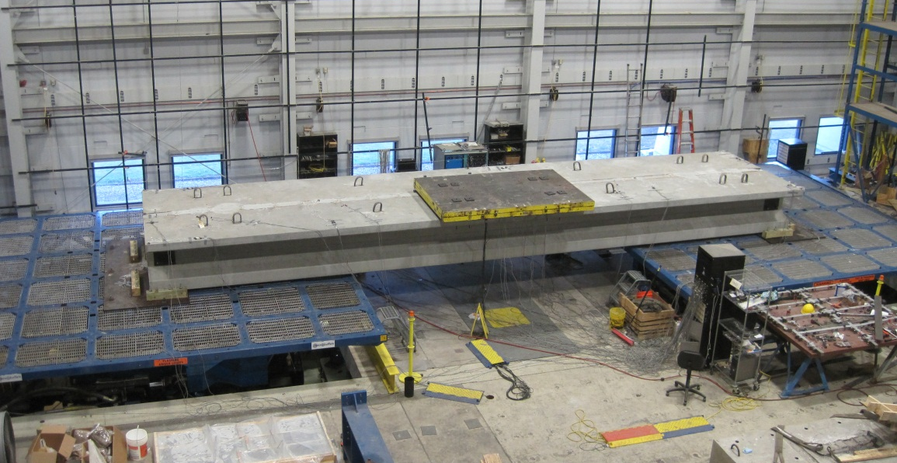
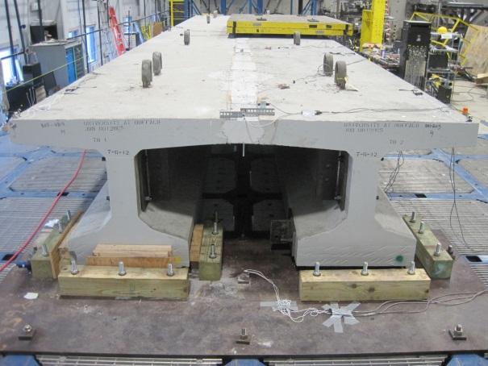
Seismic Testing of a
Deck-Bulb-Tee Connection

Slide 25
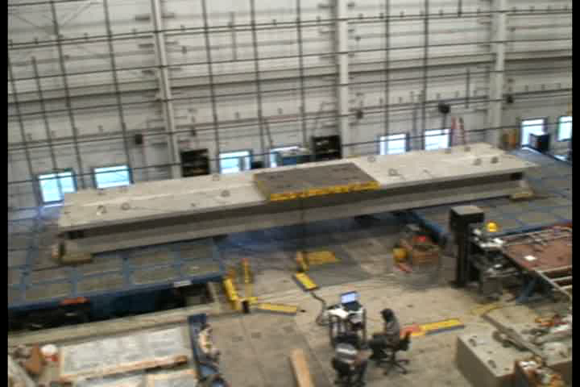
Seismic Testing of a
Deck-Bulb-Tee Connection
University of Buffalo

Slide 26
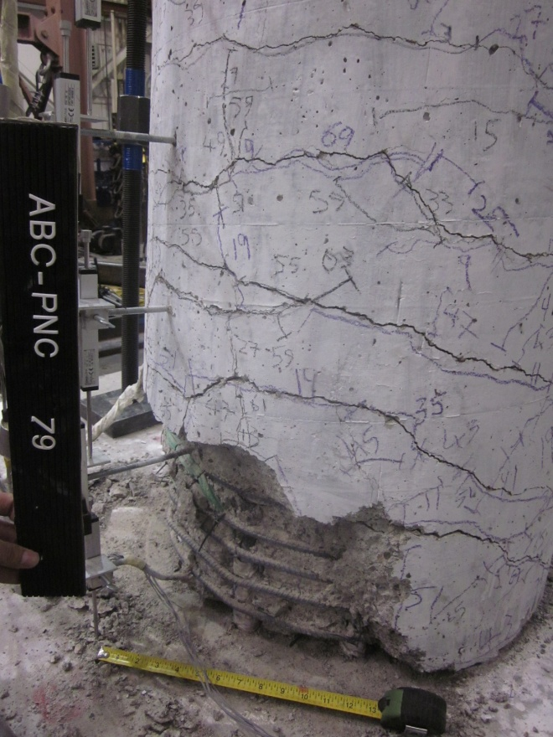
Column-to-Footing/Cap Connections
University of Nevada-Reno

Slide 27
Seismic Design of PBES Systems
Emulative connections are possible with UHPC
  Constructible, cost-effective, and robust
Connections can be located away from hinge regions
Connections may have locally higher stiffness
Connections in plate elements, walls, and/or plates-to-beams are entry points for technology adoption

Slide 28
Field-Cast Deck-to-Girder Connections
Simple Connection
No Interference
Hidden Connection
Emulates Cast-in-Place

Slide 29
Field-Cast “Interface” Connections

Slide 30
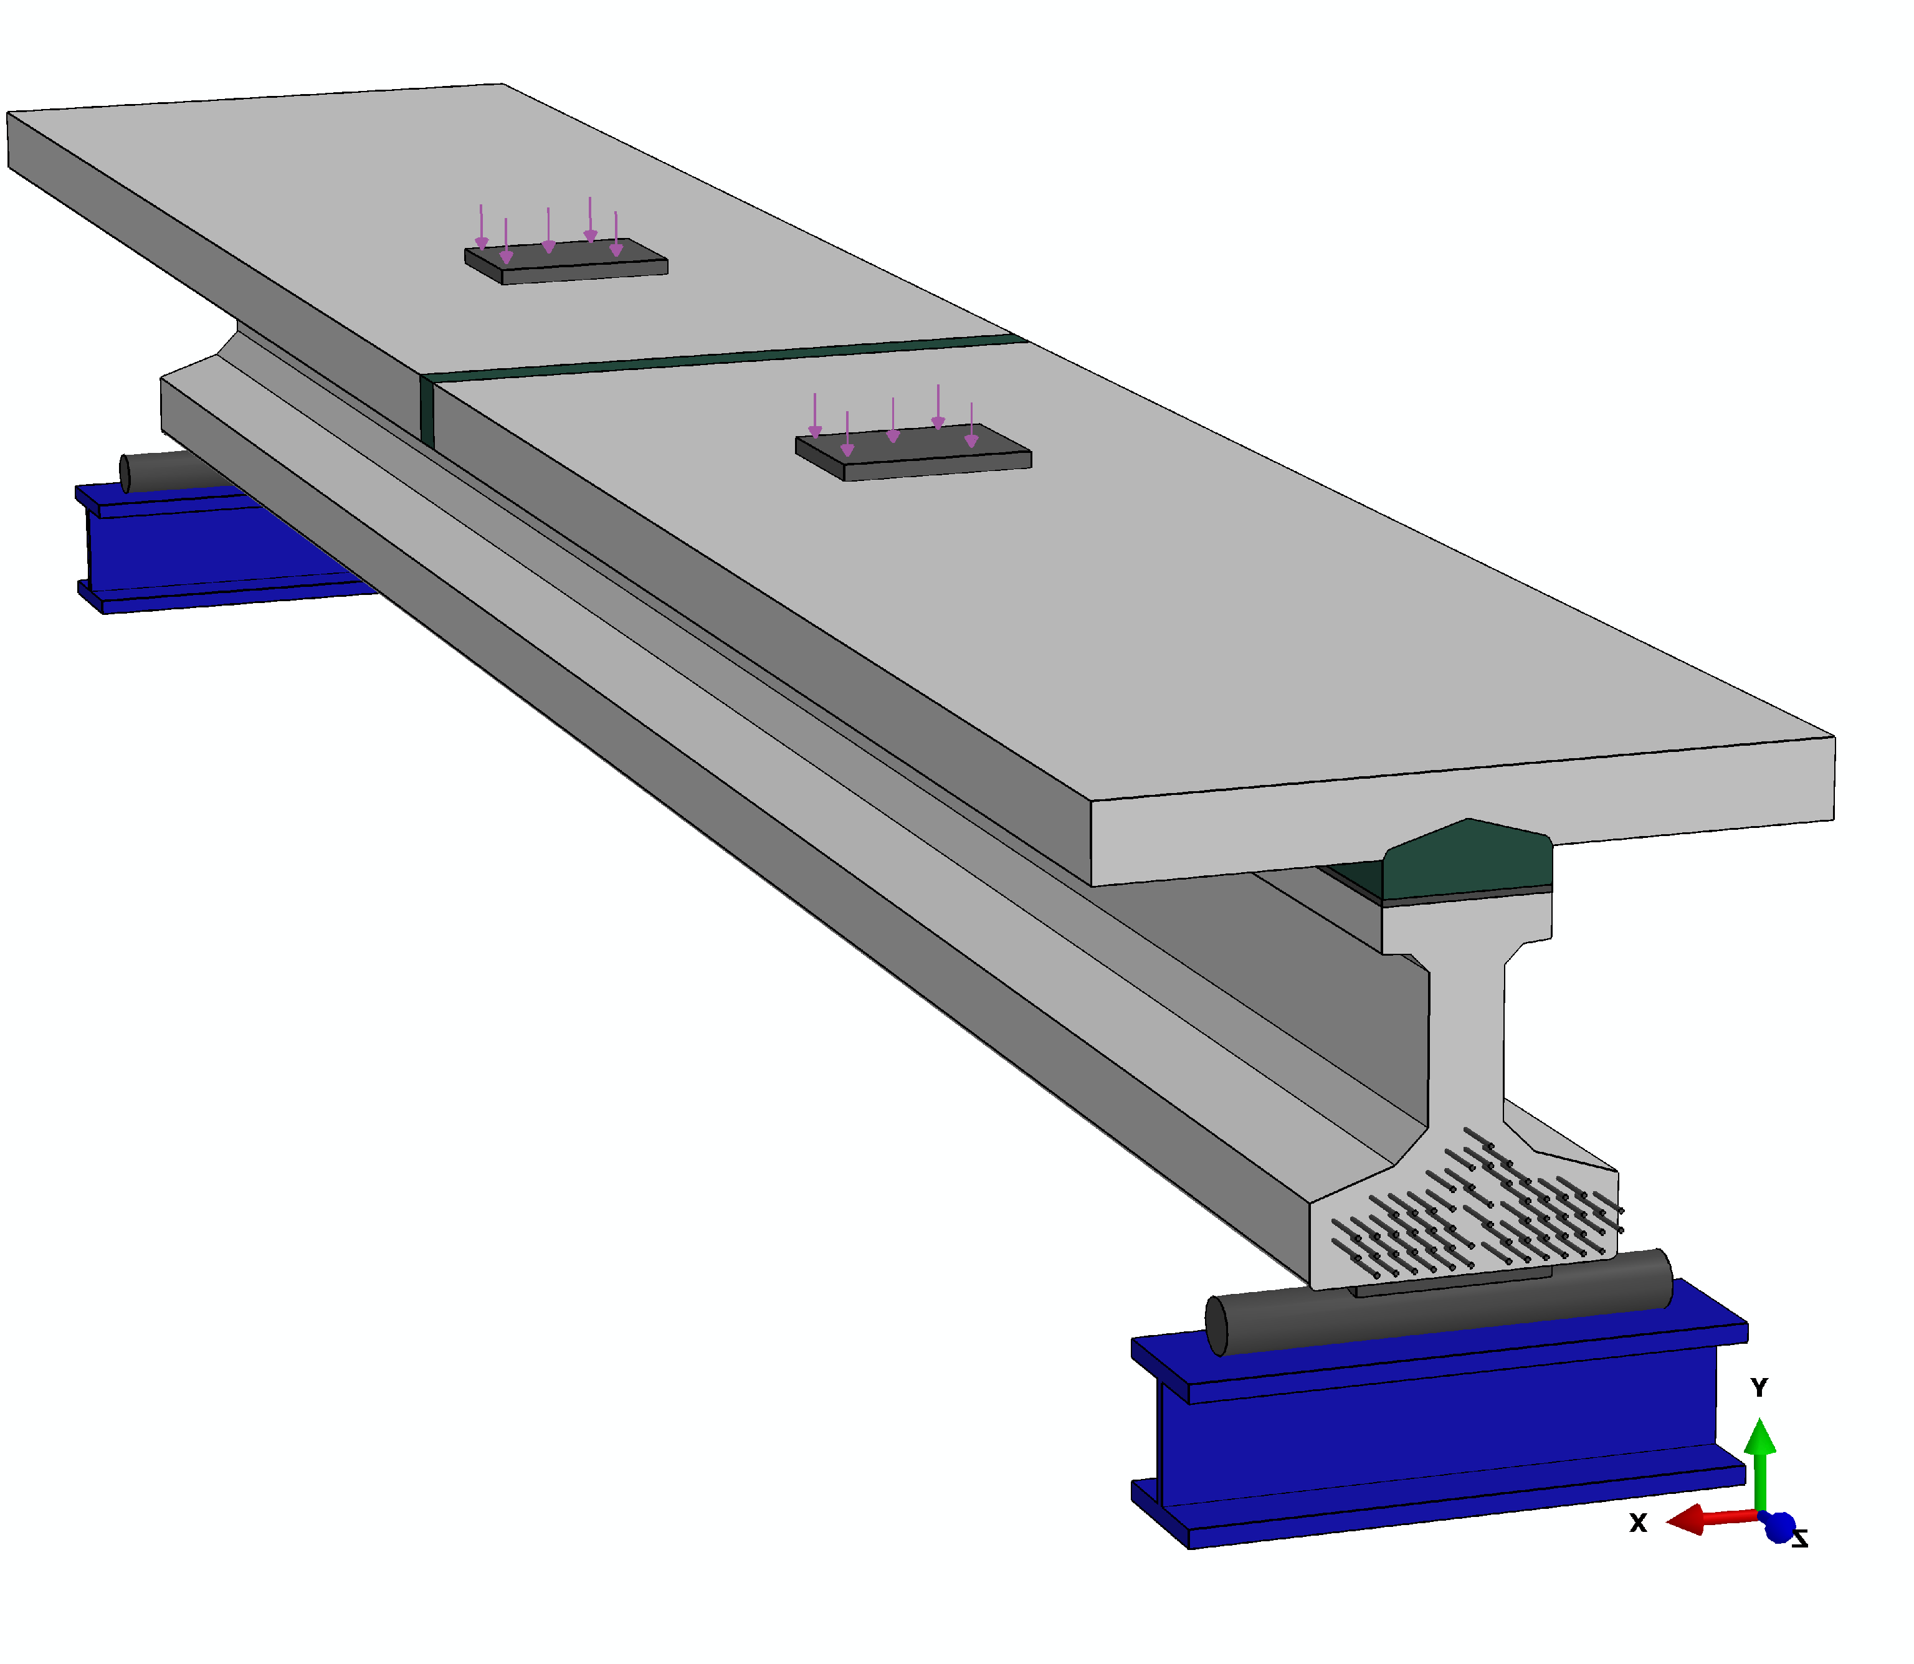
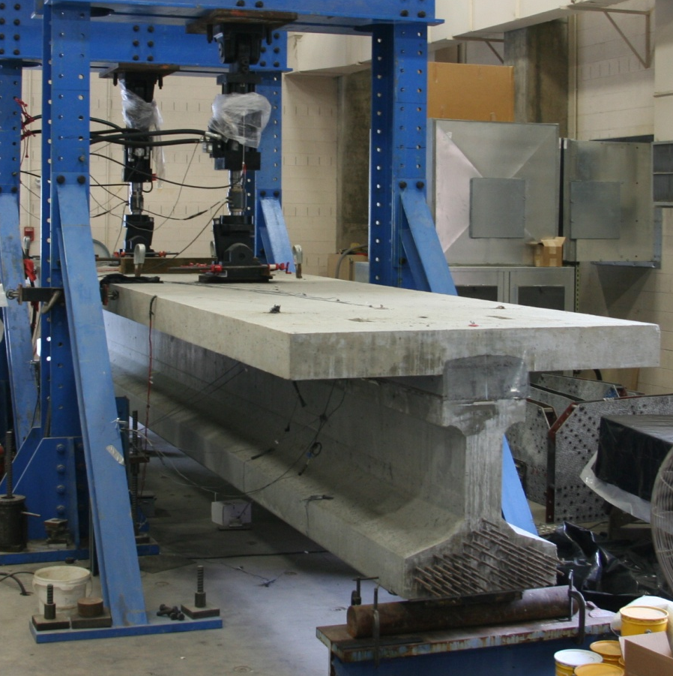
UHPC Composite Cxn Test

Slide 31
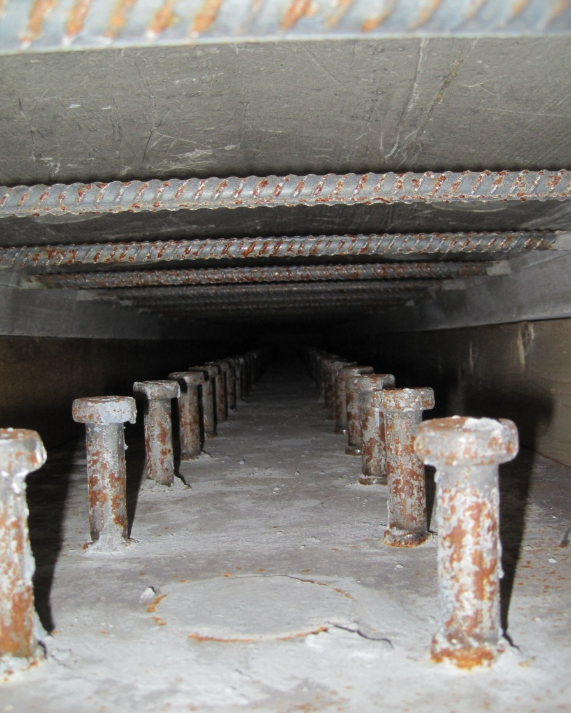
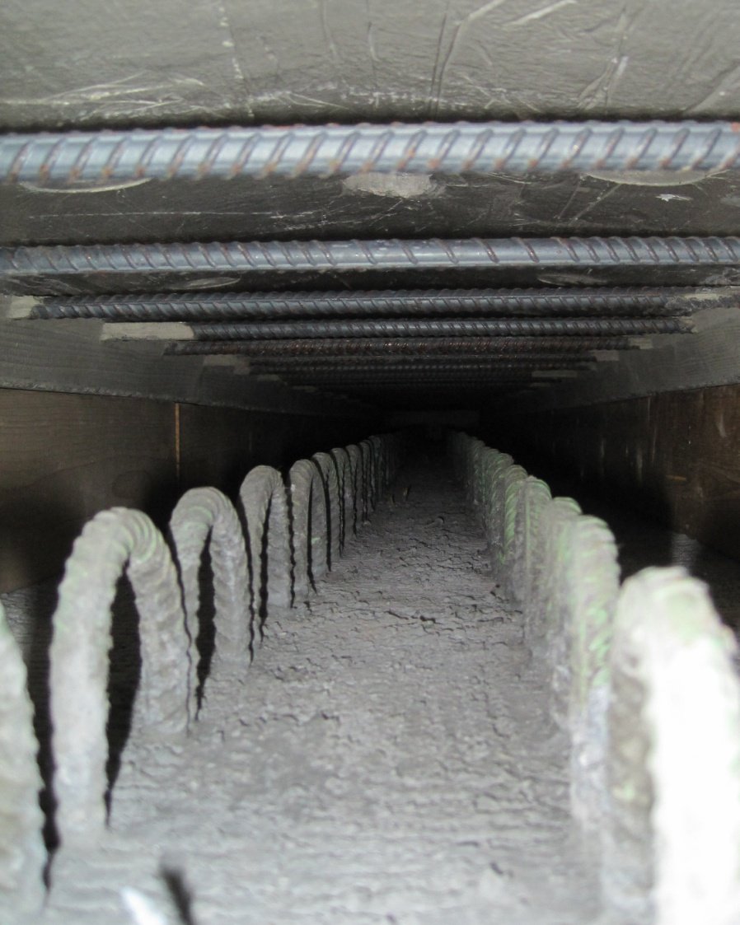
UHPC Composite Connection
Steel Girder Connection
Concrete Girder Connection

Slide 32
Composite Connections for Precast Deck Panels

Slide 34
Composite Connections for Precast Deck Panels
Full Report on Study Results
Report: NTIS PB2012-107569
TechBrief: FHWA HRT-12-042

Slide 35
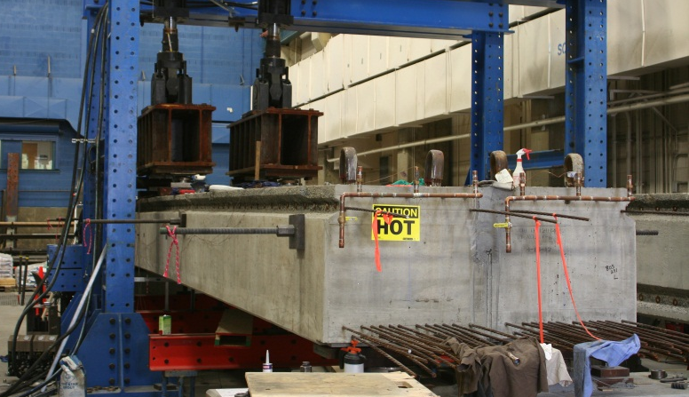
Adjacent Box Beam Connections

Slide 36
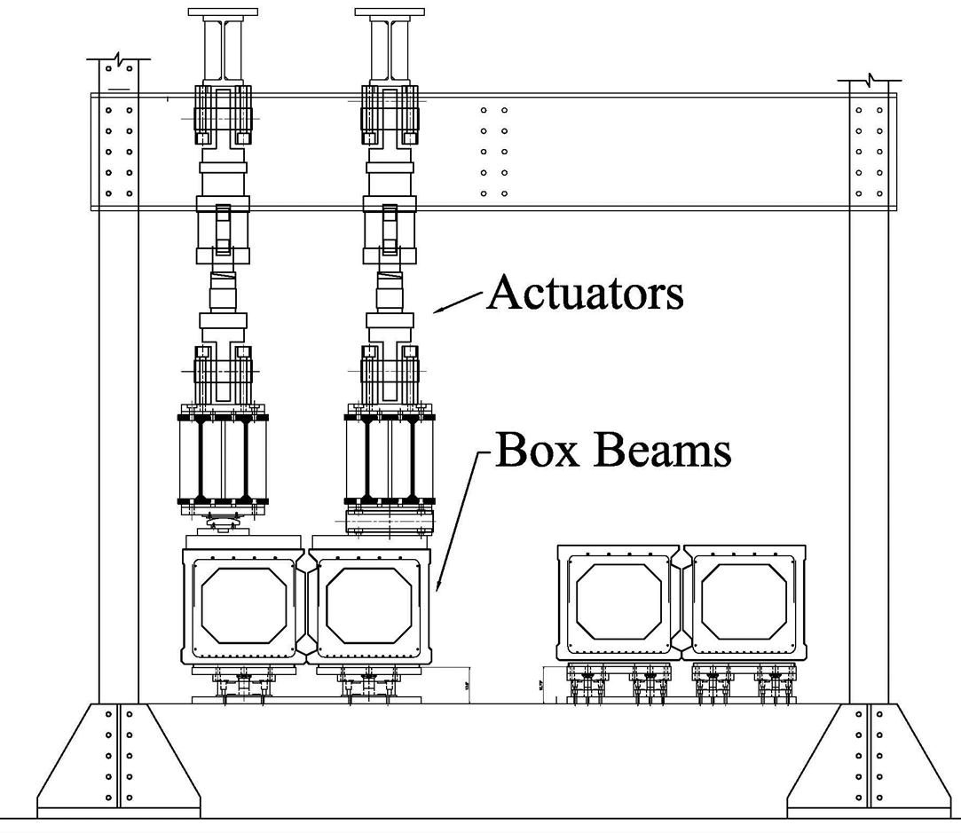
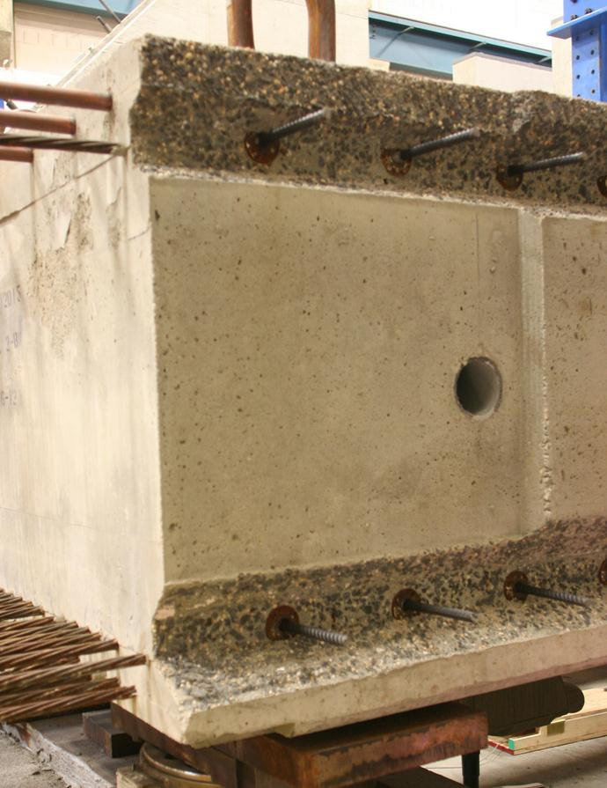
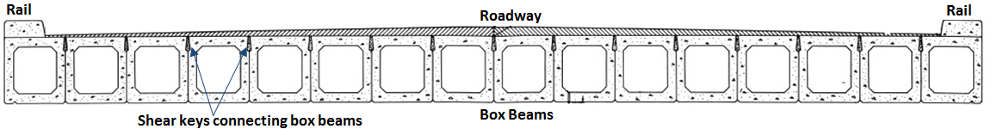
Adjacent Box Beam Connections

Slide 37
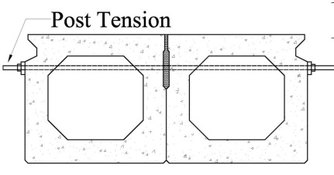
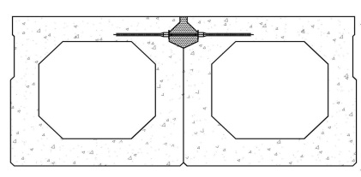
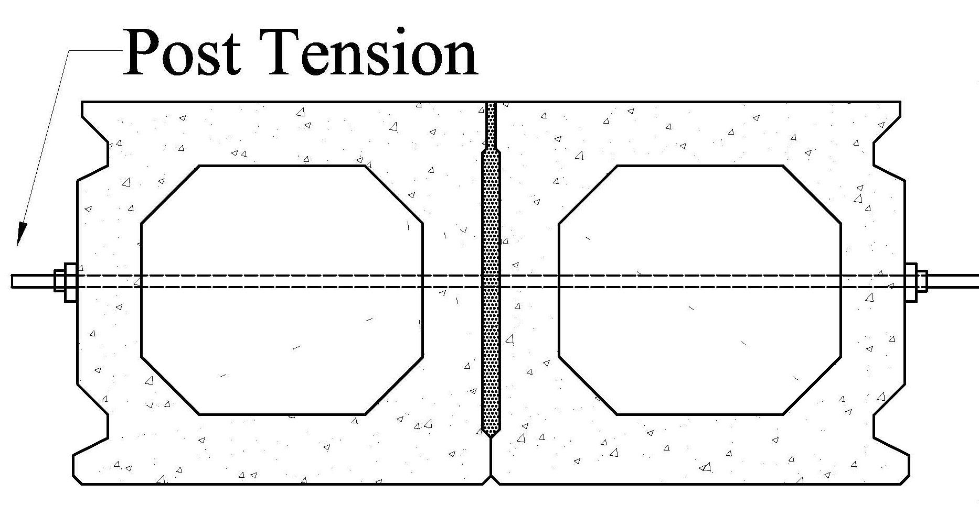
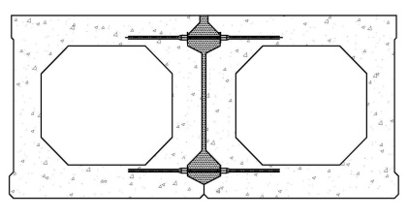
Adjacent Box Beam Connections
Traditional Solution
w/ Post-Tensioning
UHPC Connection Solution
w/o Post-Tensioning

Slide 38
PBES Research at TFHRC
Vertically Integrated Research
  Material Performance
  Component Performance
  Structural Performance

Slide 39
PBES Research at TFHRC
Vertically Integrated Research
  Material Performance
  Component Performance
  Structural Performance
Developing Solutions

Slide 40
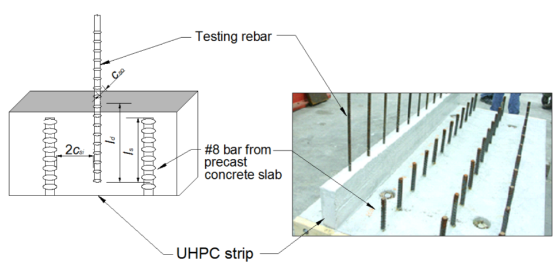
Rebar Anchorage / Splice

Slide 41
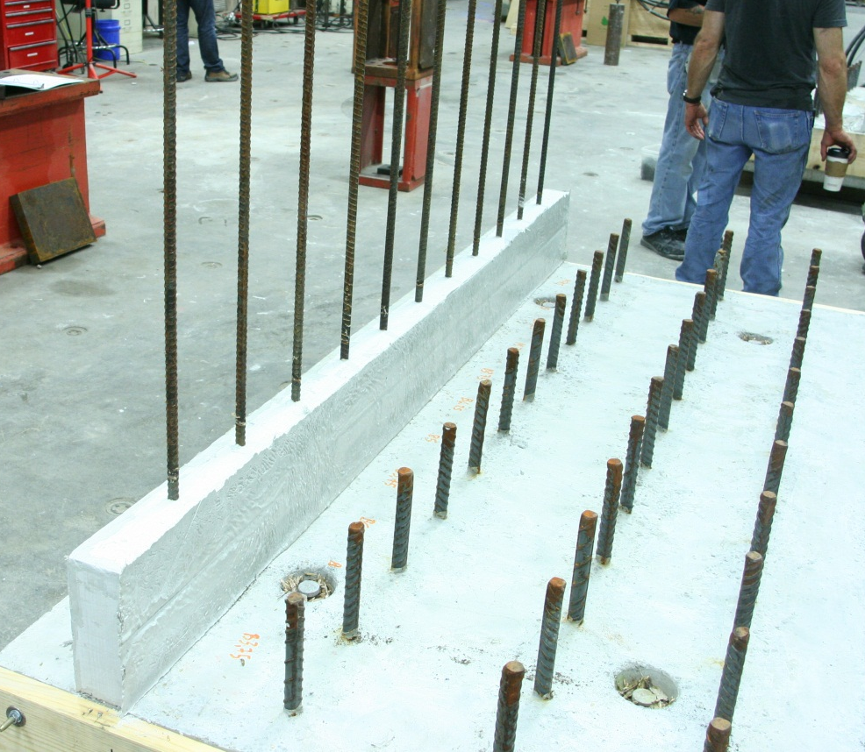
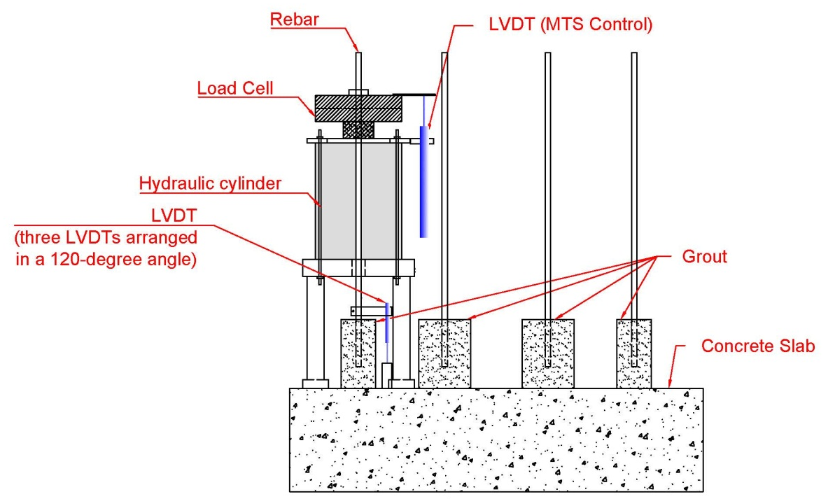
Rebar
Development
Length

Slide 42
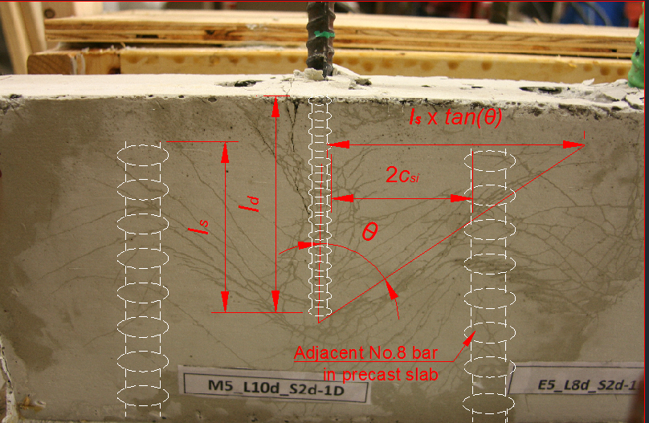
Parameters :
Type of Grout: UHPC, Epoxy, Conventional
Type of Rebar: High-Strength, Black, Epoxy, GFRP
Embedded length/spliced length
Clear spacing to adjacent bar
Side cover
Grout strength
UHPC fiber content

Slide 43
Effect of Embedment Length
Notes:
All data points are A1035 bars, size #5. Sets 1, 3, 4 have UHPC compressive strength of approximately 13.5 ksi. Set 2 has UHPC compressive strength of 19 ksi.

Slide 44

More than 200 tension-tension pullout tests
Conventional Concrete:
Given: $f_{y}$ = 70 ksi, $f_{c}^{′}$ = 13 ksi
ACI 318 $l_{d}=$ 24$d_{b}$
AASHTO $l_{d}=$ 28$d_{b}$
UHPC
1 day strength

Slide 45
Preliminary Findings on UHPC:
Black Rebar: 6d_{b} embedment for 60 ksi (yield)
UHPC at 13.5 ksi (1 day); 2d_{b} side cover
Epoxy Rebar: 8d_{b} embedment for 60 ksi (yield)
UHPC at 13.5 ksi (1 day); 2d_{b} side cover
Black, Epoxy Rebar: 10d_{b} embedment for rupture
UHPC at 19.5 ksi (7 day); 2d_{b} side cover
High Strength Rebar: 12d_{b} embedment for rupture
UHPC at 19.5 ksi (7 day); 2d_{b} side cover

Slide 46
Design Recommendation
Bar stress of at least 75 ksi before bond failure
Embedment Length, l_{d}: 8d_{b}
Side cover: 3d_{b}
Bar spacing: between 2d_{b} and l_{s}
l_{s} ≥ 0.75 l_{d}
f’_{c} ≥ 13.5 ksi
UHPC
1 day strength
Relevant for: 1) uncoated or epoxy coated bars, and 2) No.4 to No. 8 bars.

Slide 47
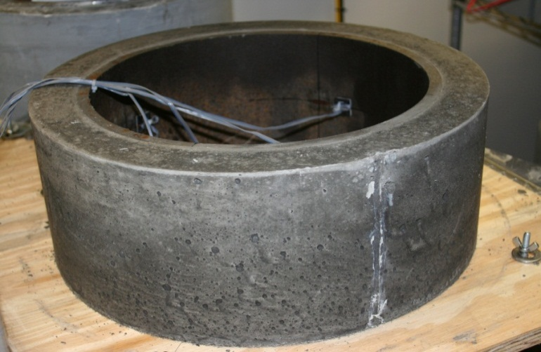
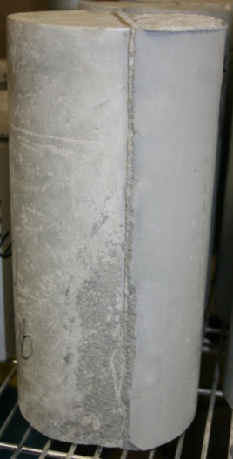
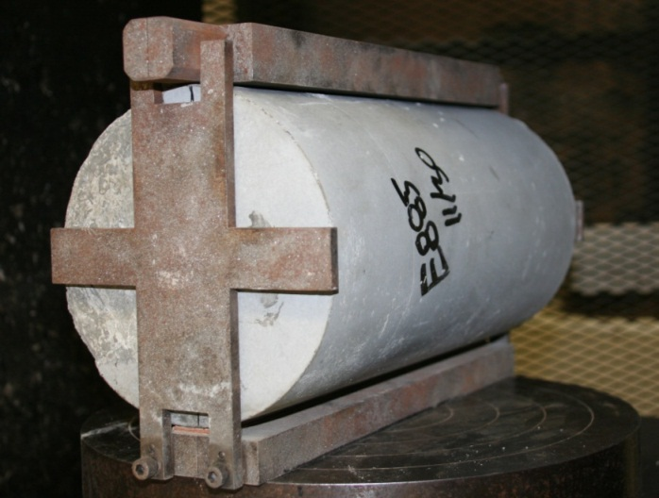
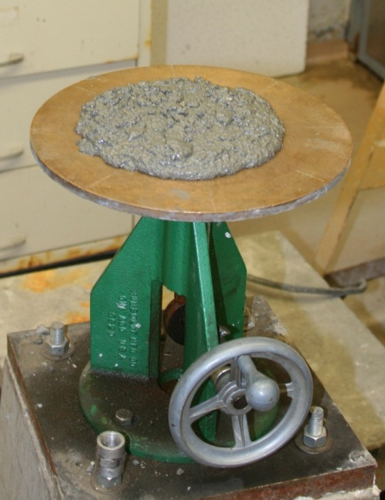
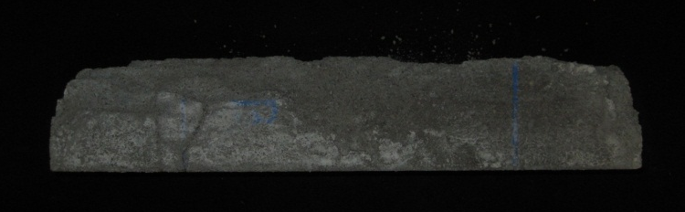
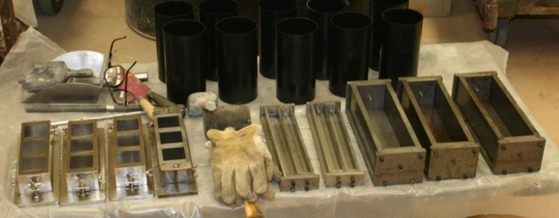
Grout Characterization

Slide 49
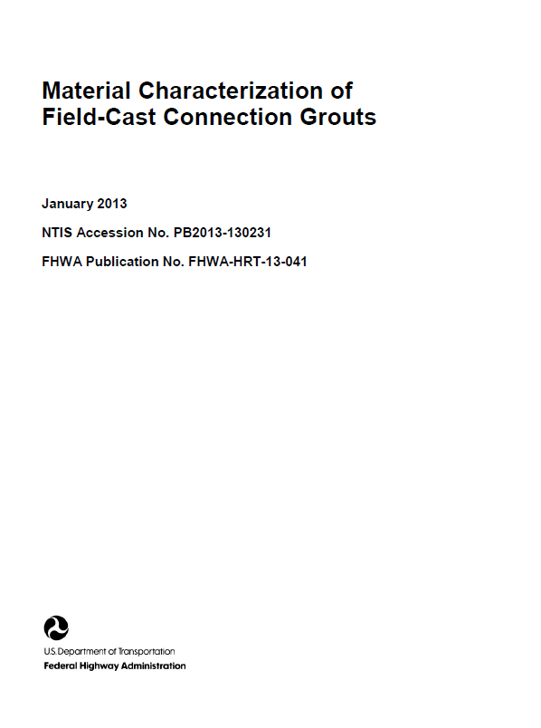
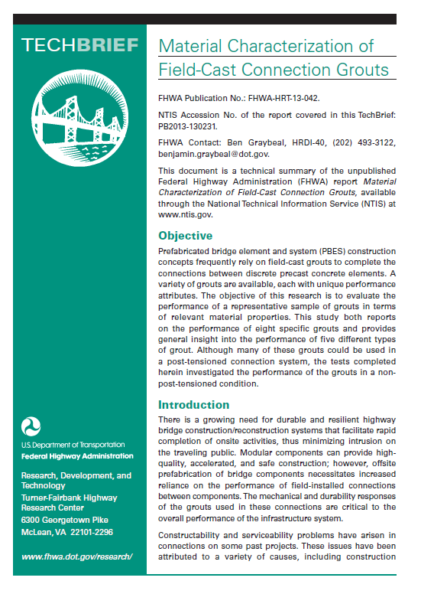
Grout Characterization
Full Report on Study Results
Report: NTIS PB2013-130231
TechBrief: FHWA HRT-13-042

Slide 50
PBES Innovation

Slide 51
PBES Innovation
I-81 in Syracuse NY ─ August 2013
Acknowledgements:
NY Accelerated Bridge Program
NYSDOT
Fort Miller Group, Inc.
Slate Hill Constructors, Inc.
Economy Paving Company, Inc.

Slide 52
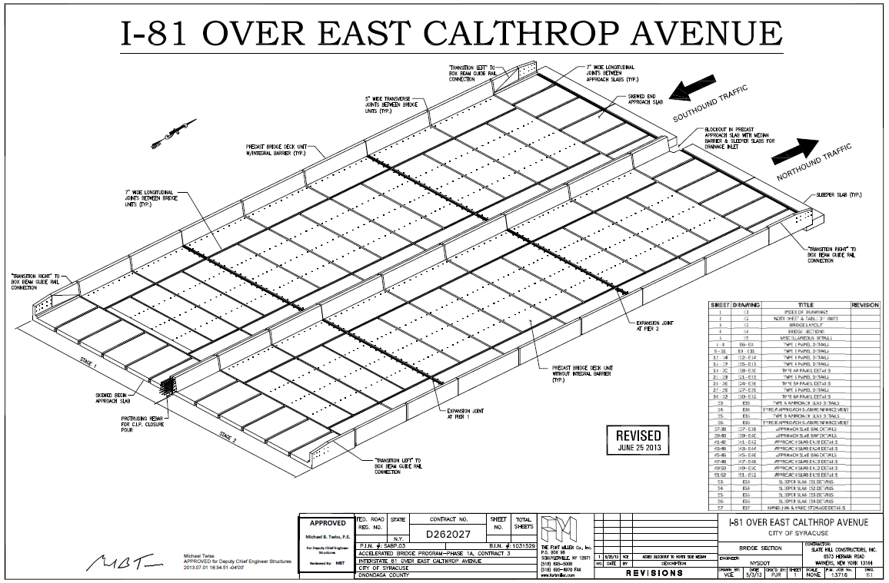

Slide 53
NYSDOT Requirements
  Complete redecking
  10-day max closure
  No overlay…Grinding OK
  Prefabricated Barriers
  May use UHPC connections
  Exposed aggregate interfaces

Slide 54
Precaster and General Contractor Developed the Details of the System
  Element Weight < 15 tons
  Element Length < 26 feet
  No Prestressing or PT
  Inverted Cast w/ Integrated Barrier
  Exposed Aggregate
  UHPC Connections
  ½” Sacrificial Surface…Ground

Slide 56
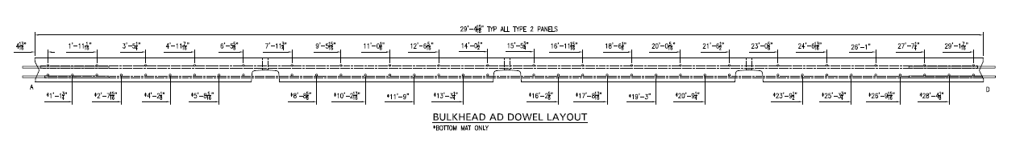
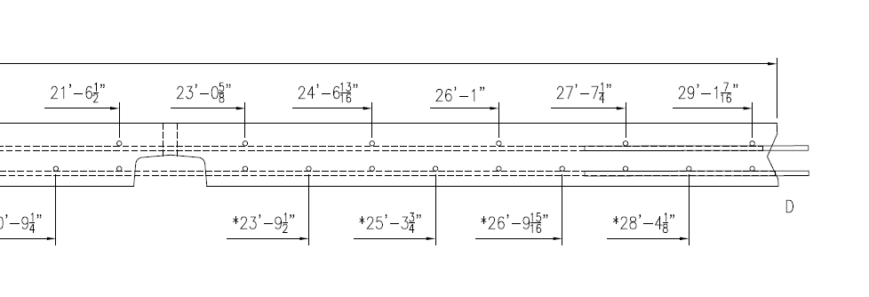

Slide 57
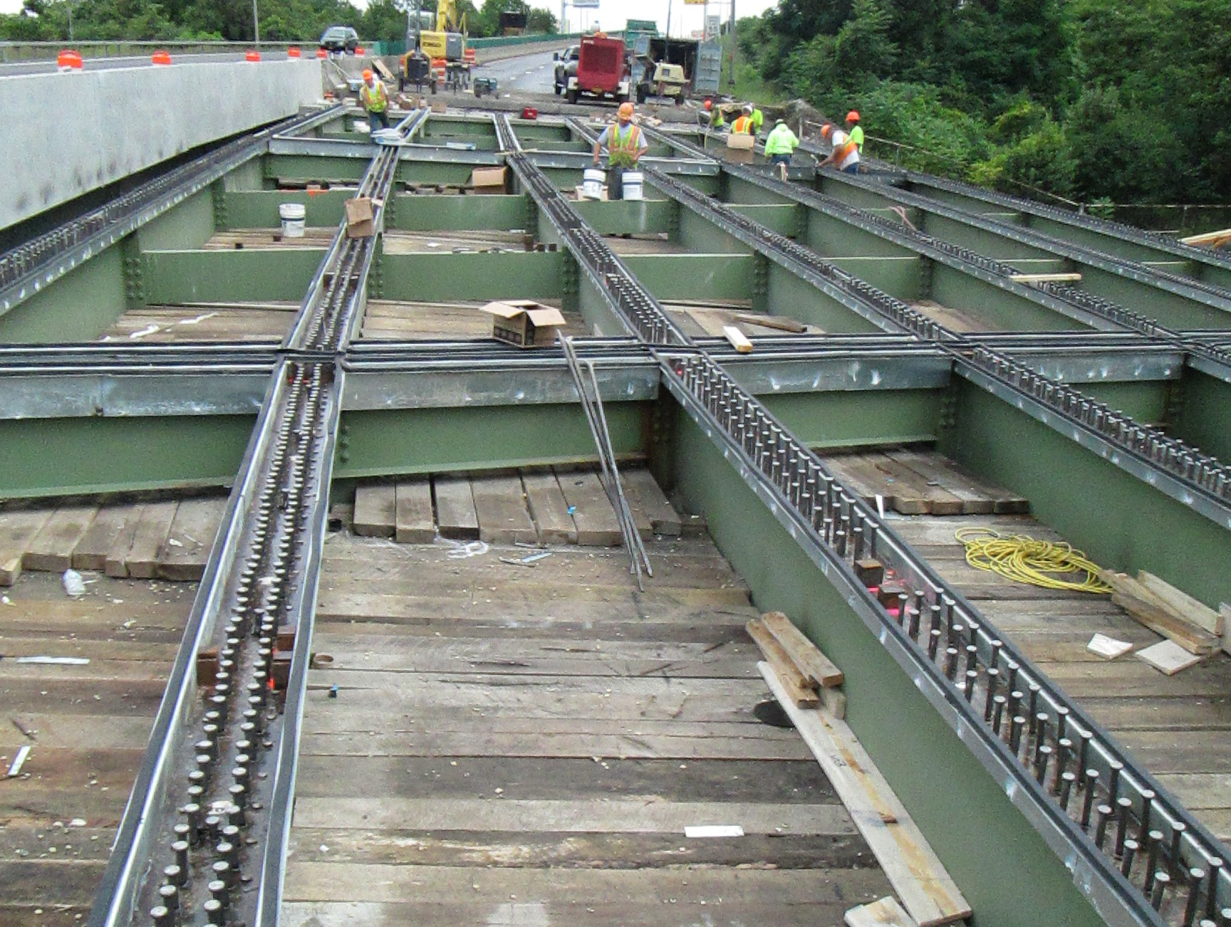

Slide 58
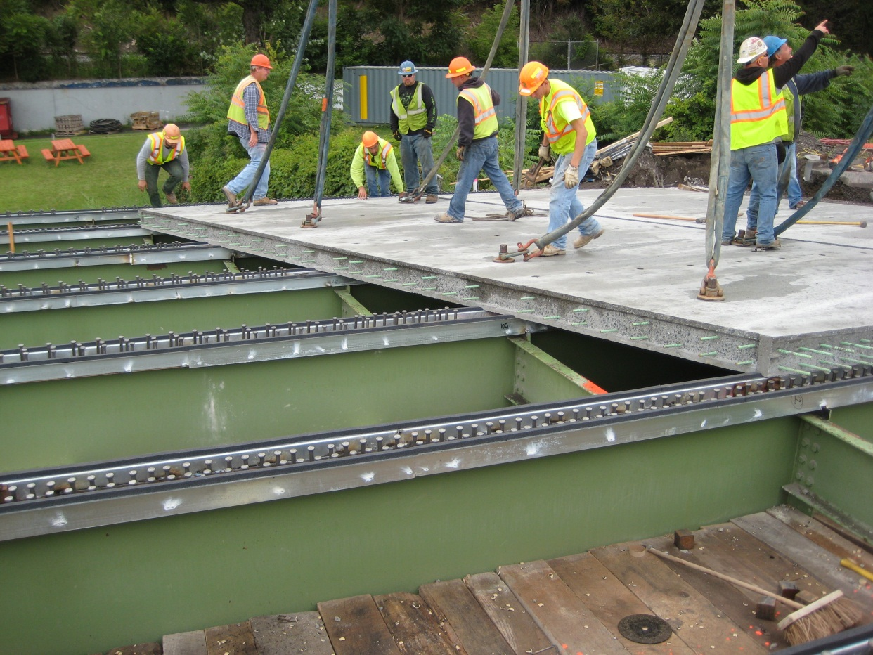

Slide 59
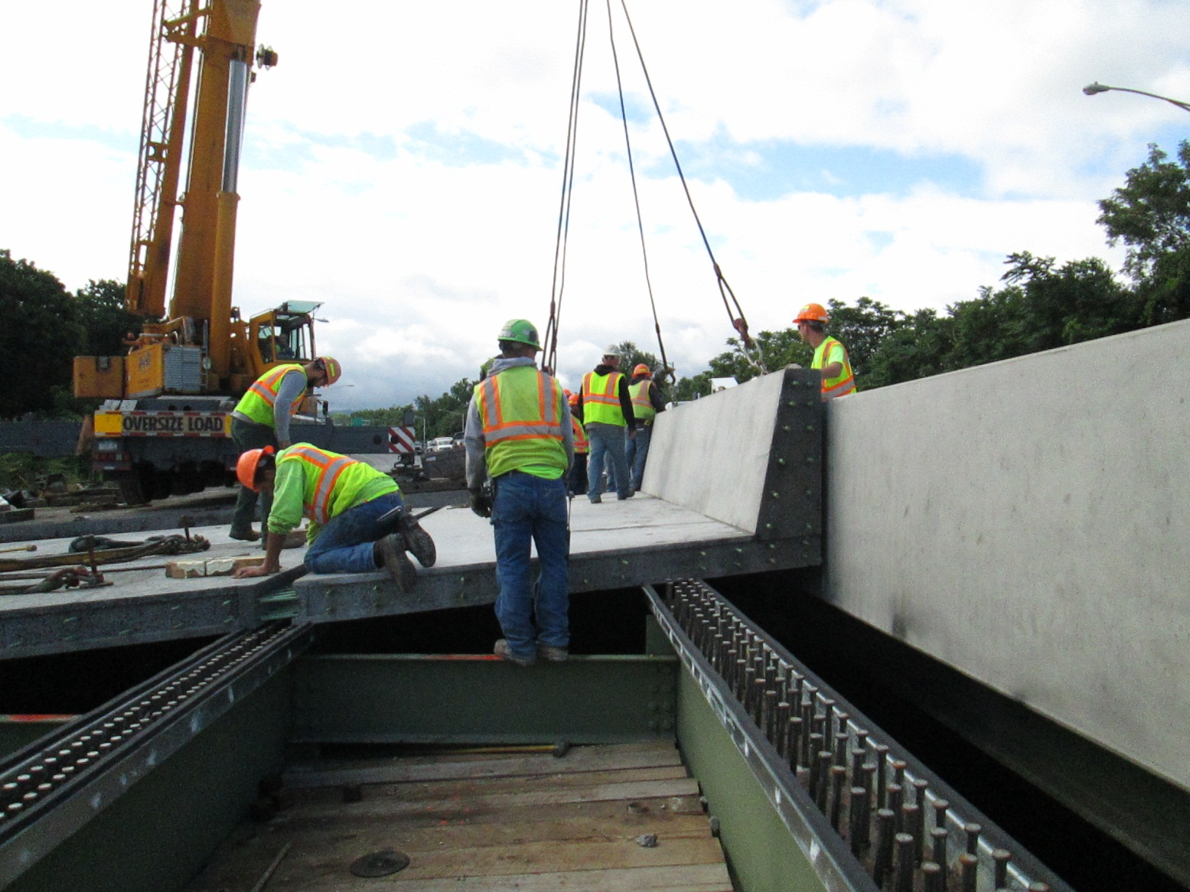

Slide 60
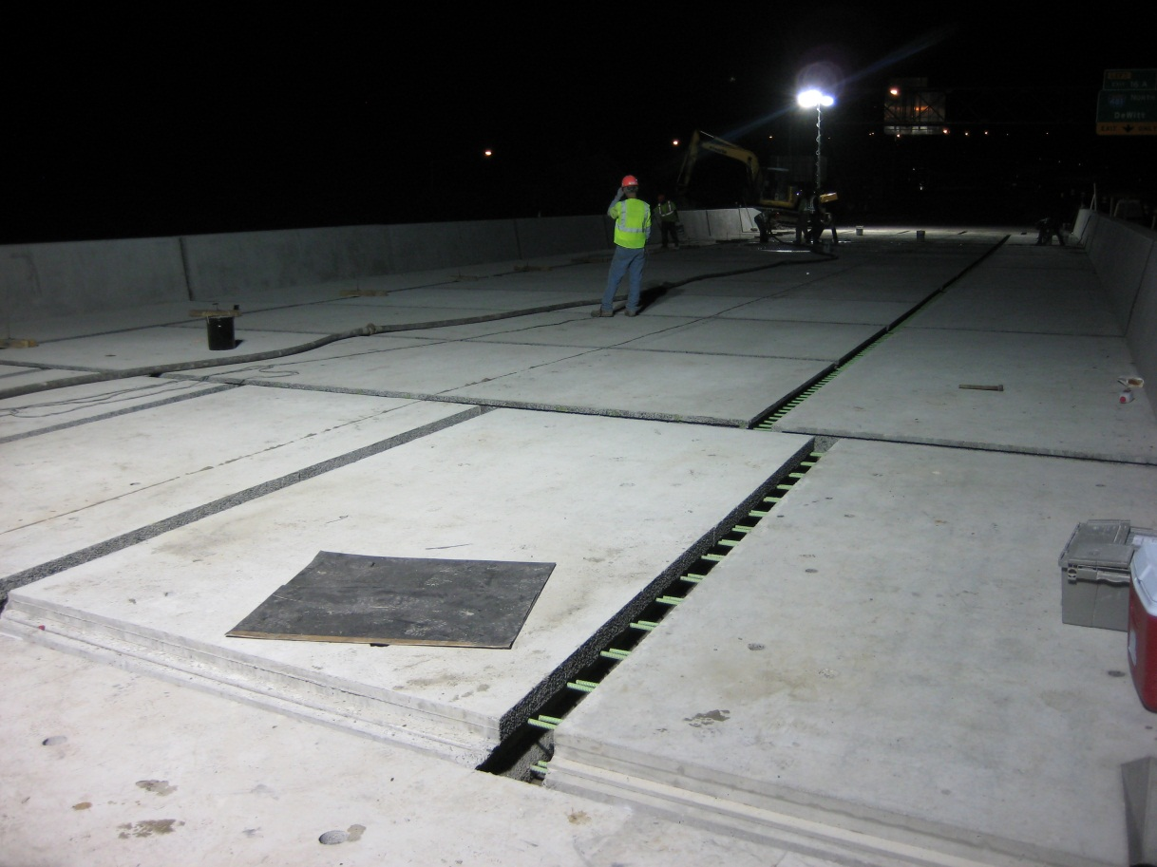

Slide 61
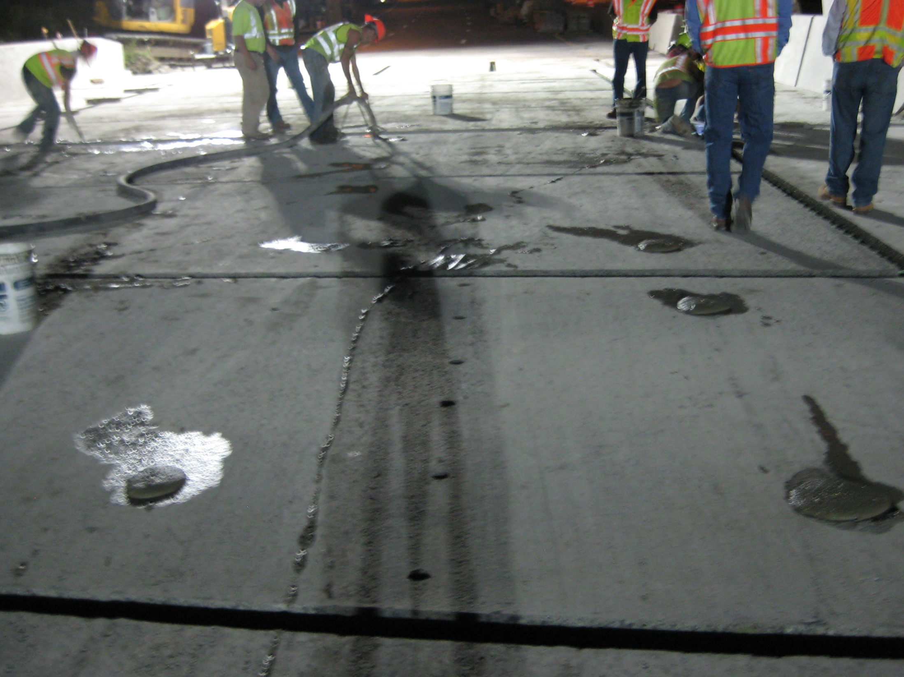
Conventional Grout

Slide 62
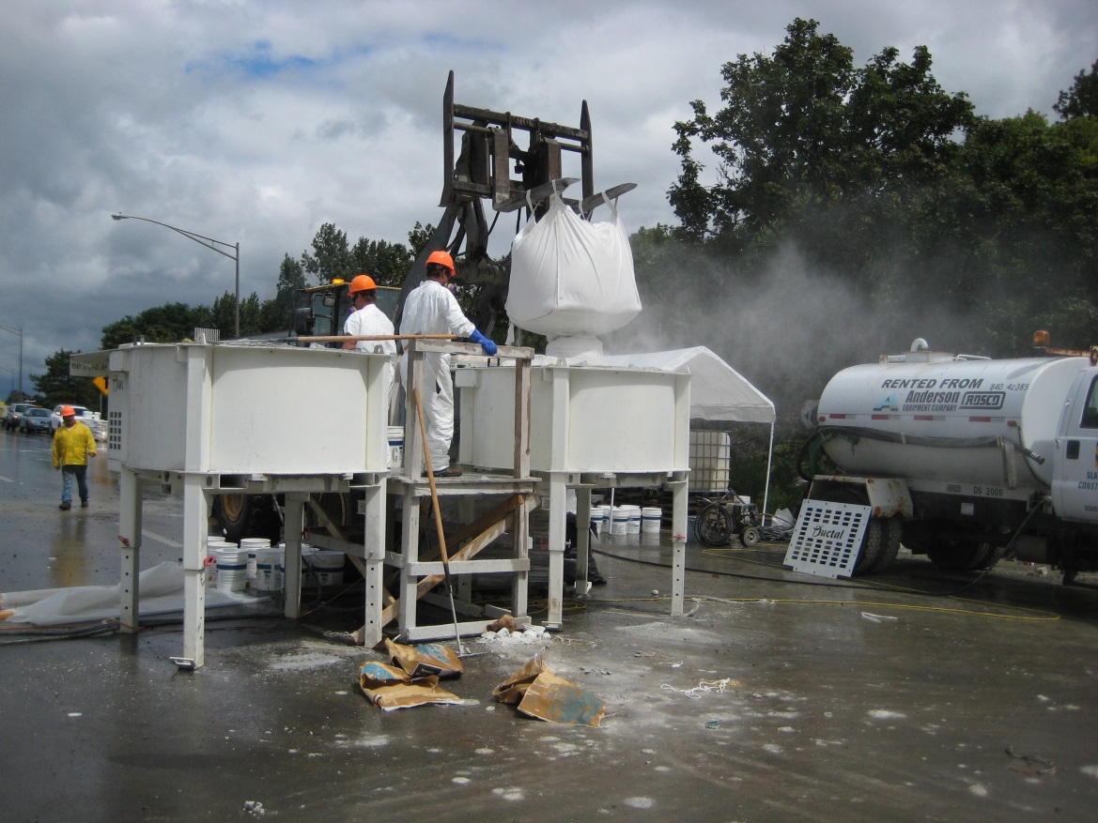
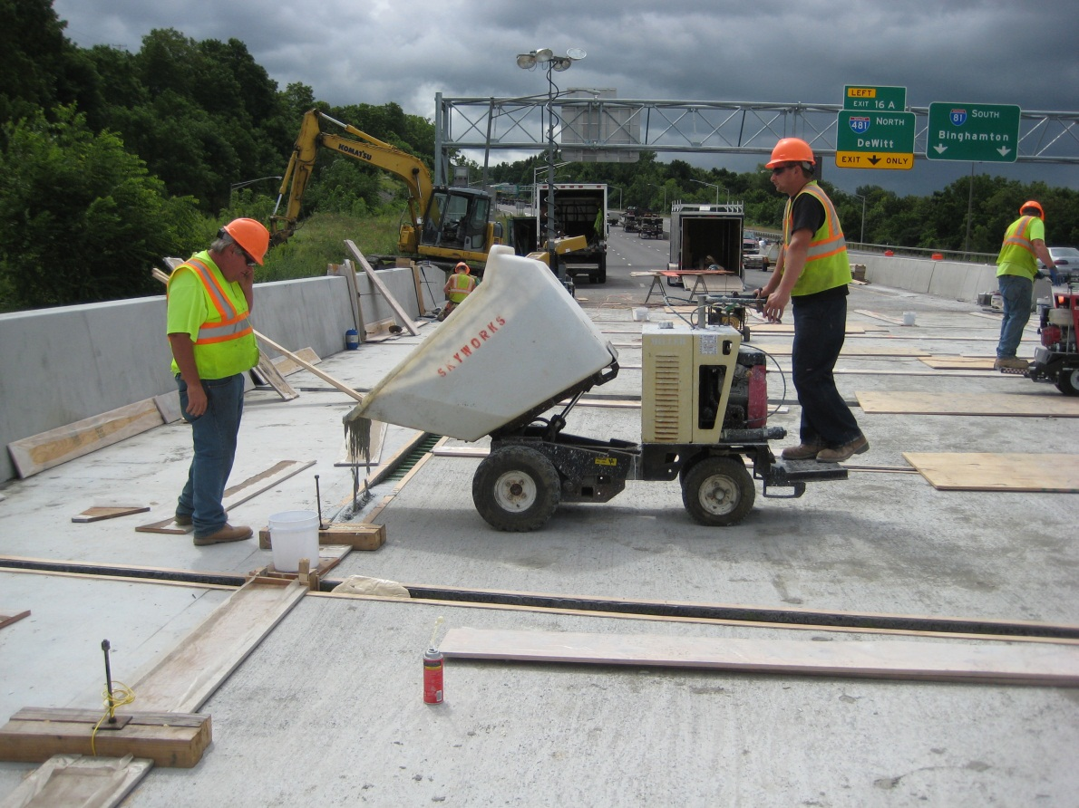
Field-Cast UHPC

Slide 63
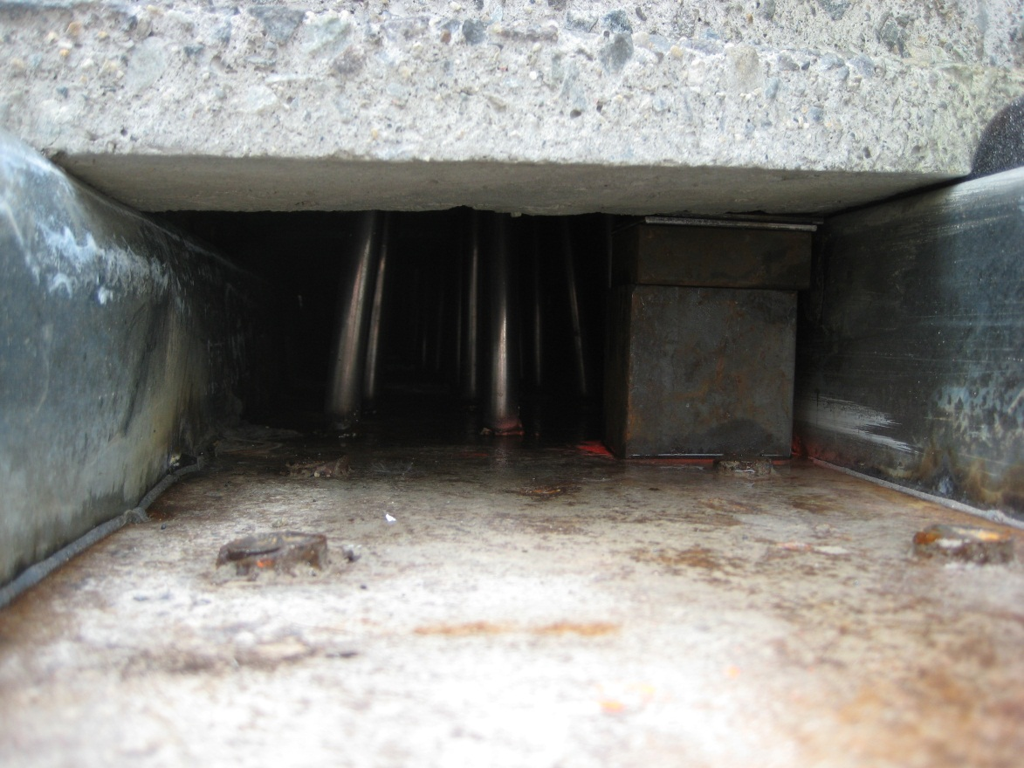
Haunch & Panel Support

Slide 64
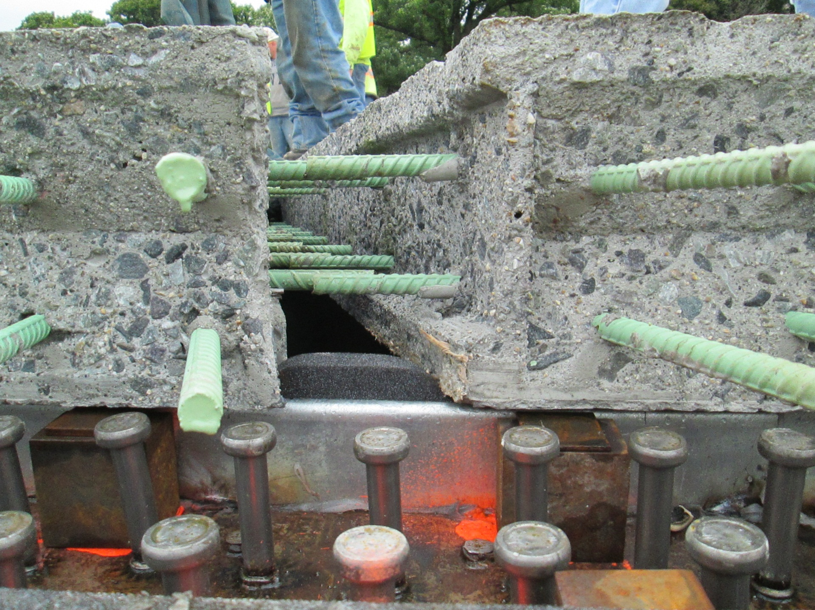
Deck-to-Deck Connection

Slide 65

Deck-to-Deck Connection

Slide 66

Deck-to-Deck Connection

Slide 67

Deck-to-Girder Connection

Slide 68

Deck-to-Girder Connection

Slide 69

Deck-to-Girder Connection

Slide 70
Deck-to-Girder Connection

Slide 71

Deck-to-Girder Connection

Slide 72

Deck-to-Girder Connection

Slide 73

Deck-to-Girder Connection

Slide 74

Deck-Barrier Components

Slide 75

Deck-Barrier Components

Slide 76

Deck-Barrier Components

Slide 77

Link Slab

Slide 78

Link Slab

Slide 79



Riding Surface

Slide 80
Name | Year
Mars Hill Bridge, Wapello County, IA | 2006
Route 624 over Cat Point Creek, Richmond County, VA | 2008
Jakway Park Bridge, Buchanan County, IA | 2008
State Route 31 over Canandaigua Outlet, Lyons, NY | 2009
State Route 23 over Otego Creek, Oneonta, NY | 2009
Little Cedar Creek, Wapello County, IA | 2011
Fingerboard Road Bridge over Staten Island Expressway, NY | 2011-2012
State Route 248 over Bennett Creek, NY | 2011
U.S. Route 30 over Burnt River and UPRR bridge, OR | 2011
U.S. Route 6 over Keg Creek, Pottawatomie County, IA | 2011
Ramapo River Bridge, Sloatsburg, NY | 2011
State Route 42 Bridges (2) near Lexington, NY | 2012
State Route 31 over Putnam Brook near Weedsport, NY | 2012
I-690 Bridges (2) over Peat Street near Syracuse, NY | 2012
I-690 Bridges (2) over Crouse Avenue near Syracuse, NY | 2012
I-481 Bridge over Kirkville Road near Syracuse, NY | 2012
Windham Bridge over BNSF Railroad on U.S. Route 87 near Moccasin, MT | 2012
State Route 12 over Spring Brook near Greene, NY | 2013
State Route 10 over Webster Brook near Dehli, NY | 2013
State Route 38 over Wilson Creek near Newark, NY | 2013
State Route 962G over U.S. Route 17 in Owego, NY | 2013
State Route 907W over U. S. Route 1 in Pelham, NY | 2013
State Route 2 Bridges (2) over SR9 in Colonie, NY | 2013
I-81 Bridges (2) over E Castle St in Syracuse, NY | 2013
I-81 Bridges (2) over E Calthrop Ave in Syracuse, NY | 2013
I-84 Bridges (2) over Dingle Road in Southeast, NY | 2013
I-690 Westbound over Onandaga Creek in Syracuse, NY | 2013
I-690 over N. Salina Street in Syracuse, NY | 2013
Bridges in Service in the U.S.

Slide 81
Name | Year
Sherbrooke Pedestrian Overpass, Quebec | 1997
Highway 11 over CN Railway at Rainy Lake, Ontario | 2006
Glenmore/Legsby Pedestrian Bridge, Calgary | 2007
Highway 11/17, Sunshine Creek, Ontario | 2007
Highway 17, Hawk Lake, Ontario | 2007-2008
Sanderling Drive Pedestrian Overpass, Calgary | 2008
Highway 105 over Buller Creek, Ontario | 2009
Highway 71 over Log River, Ontario | 2009
Route 17 over Eagle River, Ontario | 2010
La Vallee River Bridge, Ontario | 2010
Highway 105 over Wabigoon River, Ontario | 2010
Highway 105 over the Chukuni River, Ontario | 2010
Steel River Bridge on Highway 17, Ontario | 2010
Mathers Creek Bridge on Highway 71, Ontario | 2010
Noden Causeway on Highway 11, Ontario | 2010-2013
Highway 17 over Current River, Ontario | 2011
Mackenzie River Bridges (2) on Highway 11/17, Ontario | 2011
Wabigoon River Bridge on Highway 605, Ontario | 2011
Whiteman Creek Bridge on Highway 24, Ontario | 2011
Shashawanda Creek Bridge, Ontario | 2011
Hodder Ave Overpass over Highway 11/17, Ontario | 2012
Hawkeye Creek Bridge on Highway 589, Ontario | 2012
Hawkeye Creek Tributary Bridge on Highway 589, Ontario | 2012
Black River Bridge on Highway 17, Ontario | 2012
Beaver Creek Bridge on Highway 594, Ontario | 2012
Middle Lake Bridge on Highway 17A, Ontario | 2012
Bridges in Service in Canada

Slide 82

Pulaski Skyway
Newark, New Jersey

Slide 83

Guidance on Use of
UHPC Connections
FHWA document being drafted
  Design guidance
  Construction guidance
  Case Studies
Publication within 6 months
External reviews underway

Slide 84
UHPC for PBES Connections:
A Path to Accelerated Construction and Enhanced Bridge Performance
Ben Graybeal, Ph.D., P.E.
Team Leader – Bridge & Foundation Engineering
Federal Highway Administration
202-493-3122
benjamin.graybeal@dot.gov
Iowa DOT ABC Workshop — May 1-2, 2014

