Slide 1
Bicyclists and Pedestrian
Systemic Safety Analysis

Slide 2
Systemic
Safety Analysis
“The systemic approach to safety involves widely implemented Improvements based on high-risk roadway features correlated with specific severe crash types. The approach provides a more comprehensive method for safety planning and implementation that supplements and complements traditional site analysis.” *
*FHWA. 2013. Systemic Safety Project Selection Tool. Safety.fhwa.dot.gov/systemic/fhwasa13019/. U.S. Department of Transportation, Federal Highway Administration. July.

Slide 3
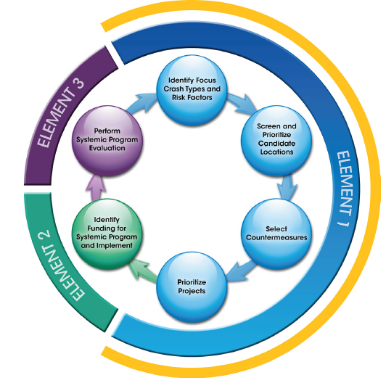
*FHWA. 2013. Systemic Safety Project Selection Tool. Safety.fhwa.dot.gov/systemic/fhwasa13019/. U.S. Department of Transportation, Federal Highway Administration. July.

Slide 4
Iowa Bicycle and Pedestrian Long Range Plan
Iowa in Motion 2045
Iowa SHSP
“Evaluate Key safety challenges pertaining to bicycling and walking and develop crash reduction strategies”
“Identify the primary urban and rural crash types occurring in Iowa and develop strategies for reducing crashes”
“Conduct enforcement campaigns related to bicycle and pedestrian awareness at targeted intersections”
“Develop methodology for bicycle and pedestrian safety audits of high crash corridors and intersections to identify adequate counter measures”

Slide 10
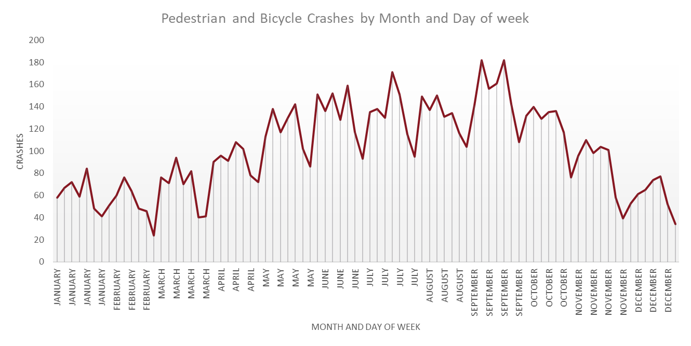

Slide 11
Other Notable Trends
Female
Male

Slide 12
Elements of Systemic Analysis
Data Sources
Crash Data 2009-2018
Intersection Database
Roadway Data (RAMS)
Software
ArcGIS
SQL Developer

Slide 13
Intersections
Attribute elements included
Number of Legs
Intersection type
Traffic Control
Intersection Angle
AADT
Speed Limit
Number of Lanes
Road Class

Slide 14
Defining Intersection Crashes
Condition 1
Must be coded as an intersection
Condition 2
Must be within 250ft of the intersection
250 ft.
Segment
Coded Crashes
Intersection Coded Crashes

Slide 15
Segments
Attribute elements included
AADT
Speed Limit
Number of Lanes
Shoulder Width
Shoulder Type
Median Type
Lane Type
Road Class
Horizontal Alignment
Vertical Alignment
Traffic Controls

Slide 16
Bicycle and Pedestrian Crashes
8160
Pedestrian
4358
Bicycle
3802
Urban
3540
Rural
303
Urban
4055
Rural
262
Segment
2423
Intersection
1589
Segment
268
Intersection
24
Segment
1523
Intersection
1981
Segment
228
Intersection
32

Slide 17
Segments
Attribute elements included
AADT
Speed Limit
Number of Lanes
Shoulder Width
Shoulder Type
Median Type
Lane Type
Road Class
Horizontal Alignment
Vertical Alignment
Traffic Controls

Slide 18
Bicycle Rural Segment
228
AADT
228
3000+
78
1,501-3,000
47
>700
57
701-1,500
46
Scoring Results
1
2
3
4

Slide 19
Bicycle Rural Segment
228
Number of Lanes
228
2 lane
221
4 lane
3
3 lane
3
5 lane
1
Scoring Results
1
2
2
3

Slide 20
Additional Elements to Consider in Scoring Methodology
Spatial Elements
Proximity to existing infrastructure
Proximity to transit stops
Proximity to converted roadways
Proximity to Schools
Crash Data
Segment level Non-motorist crashes

Slide 21
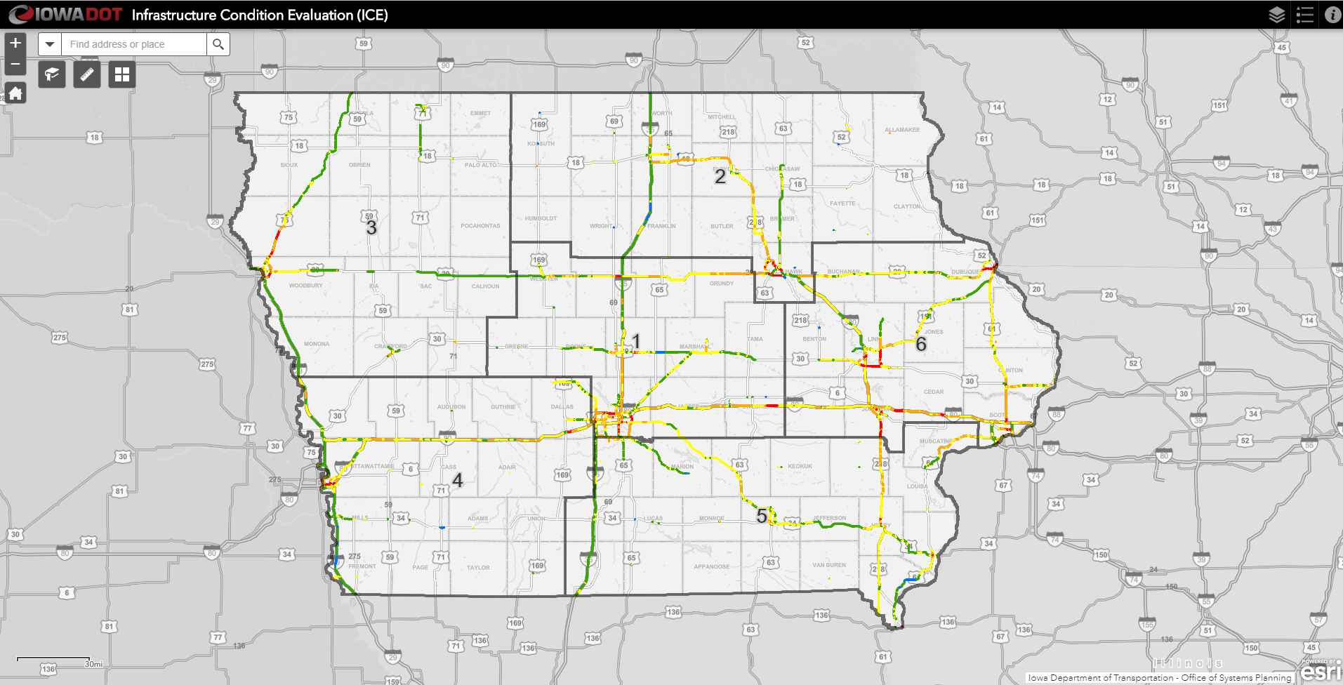
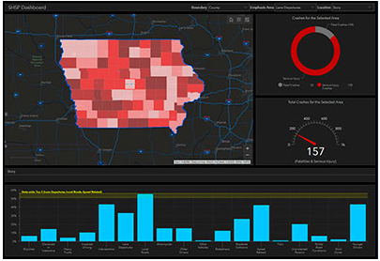
Anticipated Outputs
Segment and intersection based results
Statewide network screening
Deliverables
Technical memo
Dashboarding
Story board
Emphasis
User friendly
interactive

Slide 22
THANK YOU FOR YOUR TIME AND ATTENTION
Samuel Sturtz
Transportation Planner
Systems Planning Bureau
515-239-1788
Samuel.sturtz@iowadot.us

